Slide 1

Modern College of Arts, Science & Commerce (Autonomus) CabService Management System
By: -
Ronit Sanjay Kohinkar Erno:-8556
Aniket Pandurang Digge Erno:-7919

Slide 2
Agenda
System Overview
Technologies Used
Problem definition
Limitation of manual system
Proposed System
Design Specification
Features of the System
Limitation
Future Enhancements
Challenges
Form Desingn

Slide 3
System Overview
The aim of this project is to develop a web application software “Cab Service Management System”. It is developed to provide easy and convenient transportation of data & various activities in the proposed system. Various process followed are automated in this project. The infrastructure module describes about the details of infrastructure of the Cabs / Taxi. The modules are Admin, Customer, Employees, Driver. Each modules specific some roles of it and report structure also available and you can take 4 types of reports (Daily, Weekly, and Monthly, Yearly) etc. It is user friendly. Every panel login and check our data etc. Employees can see the full reports and admin can see the full rights and maintenance of this application.

Slide 4


Technologies Used HARDWARE REQUIREMENTS: Processor: - Dual Core Processor and Above RAM: - 2 GB Hard Disk: - 5 GB External Device: - Printer
SOFTWARE REQUIREMENTS:
Front-End: -HTML/Css BootStrap 5.1
Back-End: - Wamp Server 3.2.6,MySQL 5.6,PHP.
Tools: - Visual Studio Code 1.62.2.

Slide 5
Problem Definition
In the existing system the case details are maintained manually. The application details employee details, driver details, car details, customer details etc. Are maintained manually. The study of the existing system revealed that the system has several drawbacks.
Limitations:
The existing system has no security measures.
The system does not have any reports and thus did not help management in decision-making.
The case information’s per day is unable to find.
It’s time consuming.
Chances for errors because the data are maintained manually.
Existing system uses different system to maintain employee, drivers, cars and customer data
Coordination with customer is manually so can’t reach toward all customer’s directly.

Slide 6
Proposed System
The proposed system is computerized one, in which time is greatly reduced. Since this is a computerized one there will be no chances of human error to encounter. In the proposed system there will be a lot of improvement in the quality, speed and efficiency. This system is all in one because in proposed system cab service agency can maintain employee’s and drivers data as well. Since it is user friendly any one can operate individually. Also it does not contain paper usage as compared to Existing System.

Slide 7
List of Process within System
Add Cab :- In this page user can add cab details. This page can access by admin and employee.
Edit/Delete Cab :- In this page user can edit/delete cab details. This page can access by the admin and employee.
Cab Log :- In this log/report all the details of cabs which are available in particular cab service agency are maintain. This page can access by the admin and employee.
Add Driver :- In this page user can add Driver details. This page can access by the admin and employee.
Edit/Delete Driver :- In this page user can edit/delete driver details of particular cab service agency. This page can access by the admin and employee.
Driver Log :- In this log/report all the details of drivers which are working in particular cab service agency are maintain. This page can access by the admin and employee.
Add Employee :- In this page user can add employee details. This page can access only by admin.
Edit/Delete Employee :- In this page user can edit/delete employee details. This page can access by admin.
Employee Log :- In this log/report all the details of employee which are working in particular cab service agency are maintain. This page can access by the admin.
Booking Process :- In this page customer’s booking will display and admin/employee will process for that booking this page can access by admin and employee.
Booking Log :- In this log/report all the details of booking’s which are done in particular cab service agency are maintain. This page can access by the admin and employee.
Employee Attendance :- Attendance of employee’s is maintain in this page. Only admin can access this page.
Driver Attendance :- Attendance of driver’s maintain in this page. Only admin can access this page.
Employee Attendance Log :- In this page attendance log is maintain for the salary paid to employee. This page is accessed by only admin.
Driver Attendance Log :- In this page attendance log is maintain for the salary paid to driver. This page is accessed by only admin

Slide 8
List of Process within System
17.Employee Salary Log :- In this page log/report of salary paid to employee is maintain. The access for this page is only for admin.
18.Driver Payment :- It’s payment gateway for salary payment of driver. This page can access by only admin.
19.Driver Salary Log :- In this page log/report of salary paid to driver is maintain. The access for this page is only for admin.
20.Customer Log :- In this page log/report of all the customers who received cab service from the cab service agency. Admin and employee can access this page
21.Home :- This is the main page of this web site. Any visitor can access by this page.
22.Customer Details :- This page include form which have to fill by customer for the record. Any visitor can fill this form.
23.Fleet :- This page include all the information about all the cab’s which are available in particular cab service agency. Any visitor can access by this page.
24.Packages :- This page maintain all the packages details provided by cab service agency. Any visitor can access by this page. 25.Add Package :- In this page user can add package details. This page can access by the admin and employee.
26.Edit/Delete Package :- In this page user can edit/delete packages details of particular cab service agency. This page can access by the admin and employee.
27.Employee Payment :- It’s payment gateway for salary payment of employee. This page can access by only admin.
28.Enquiry :- This page include enquiry form for the any visitor who want to know something more about cab service agency or there service’s.
29.Payment Gateway :- It’s a payment gateway for visitor to pay for service to cab service agency.
30.Customer Feedback :- This page include feedback form which have to fill by customer for the future enhancement. Any visitor can fill this form

Slide 9
Design Specification
Entity Relation Diagram(ERD).
Context Level Data flow Diagram
DFD Level 1

Slide 10
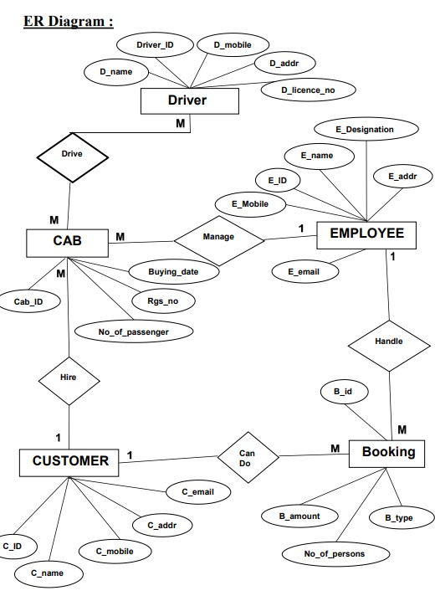
Entity Relation Diagram[ERD]

Slide 11
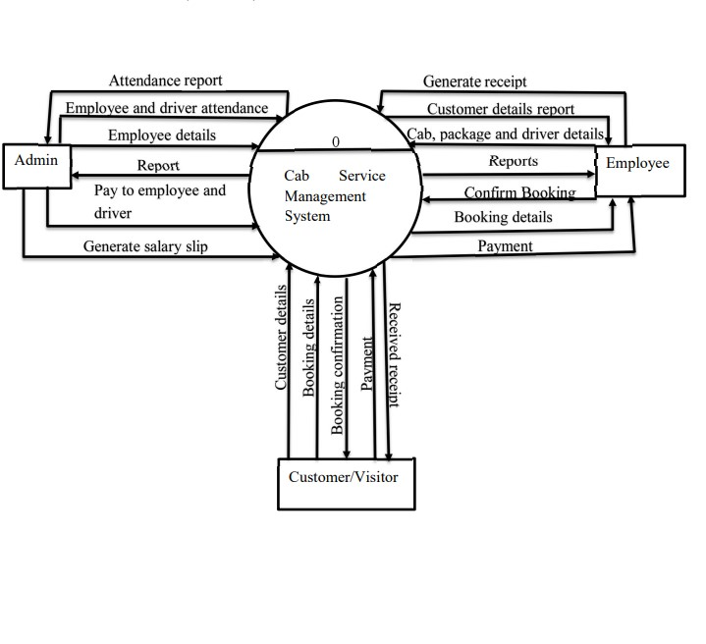
Context Level DFD

Slide 12
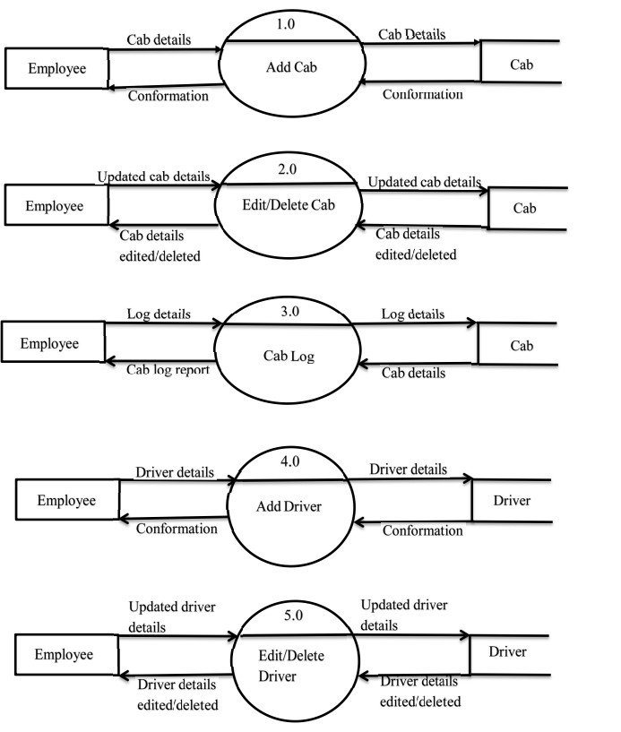
Level 1 DFD

Slide 13
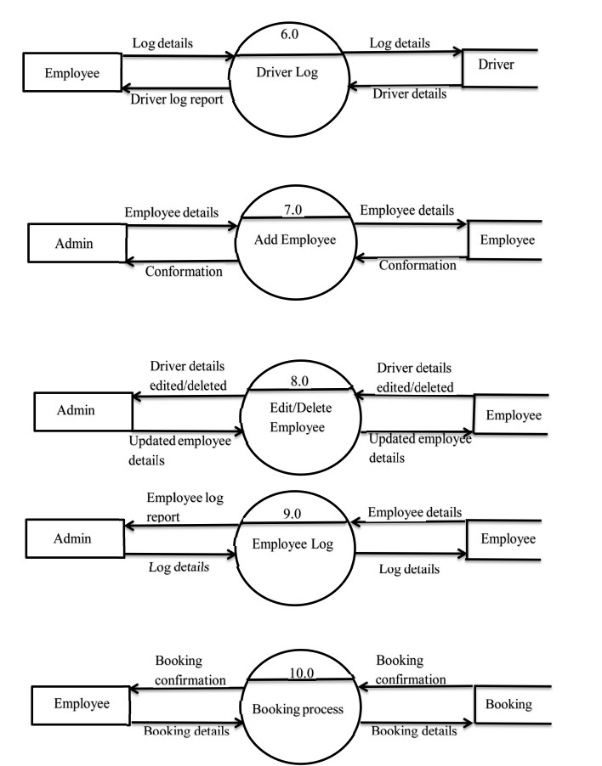

Slide 14
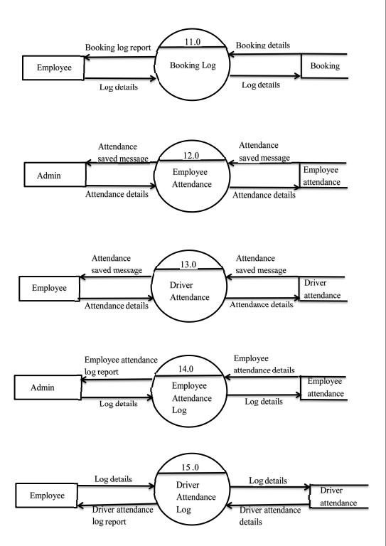

Slide 15
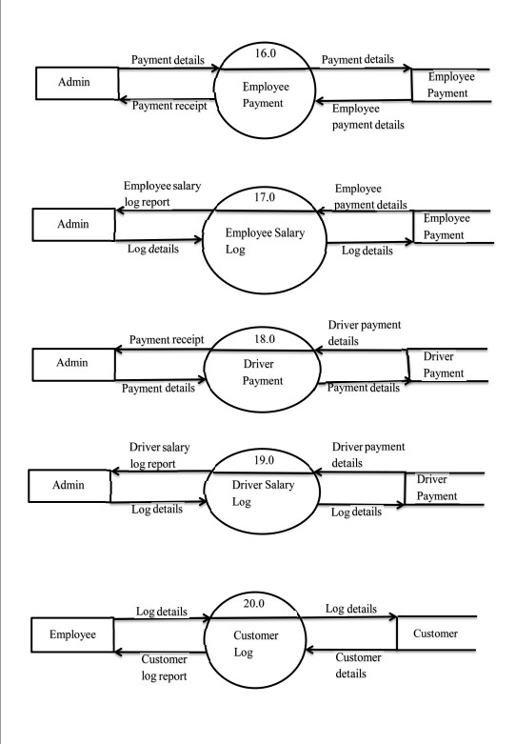

Slide 16
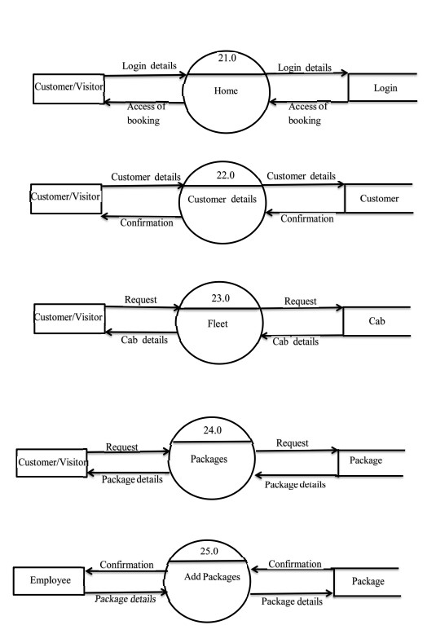

Slide 17
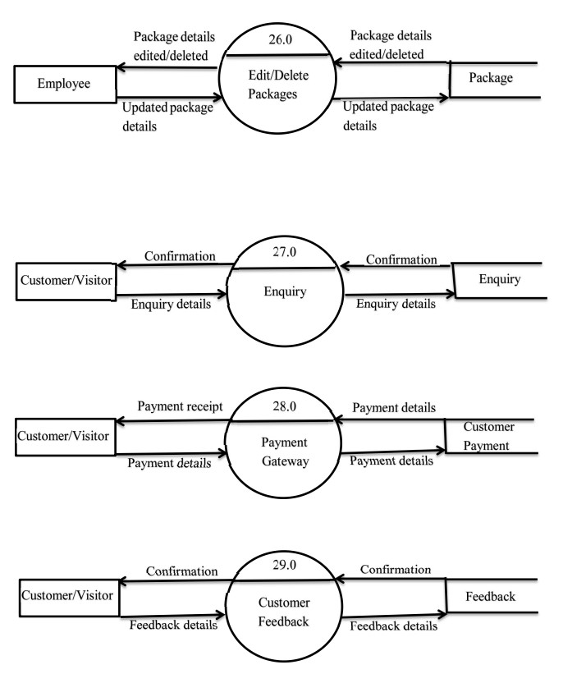

Slide 18
Features of System
Computerized the current manual system.
User friendly interface.
Proper authentication is provided to a particular user.
Due to login feature security will take place.
It is computerized system so it minimize the use of paper.
It reduces man power and save time.
Reduces human errors.
Storage of data is easy.

Slide 19
Future Enhancement
Every application has its own merits and demerits. The projects has covered all the requirements. Further requirement and improvement can easily done since the coding is mainly structured for this project. Changing the existing modules or adding new modules can be a improvements. In future the system not only access by admin, customer and employee but also access by drivers by that agency will required less manpower and less time to do work. Security of system will also enhance by providing appropriate authentication to appropriate user. GUI will also be good in future.

Slide 20
Challenges
The main Challenge we faced during the creation phase of the project was that we had to clone the project through GITHUB & GIT which was easy at first but due to different location/Paths of Laptops cloning of the project was an issue if one wants to implement changes it was unable to clone and push changes in Repository.
The other challenge was the Databinding & Access Database Connection & also the Report Generation was an issue.
The Map Implementation was an Issue we faced since making the map responsive was an Tough process.

Slide 21
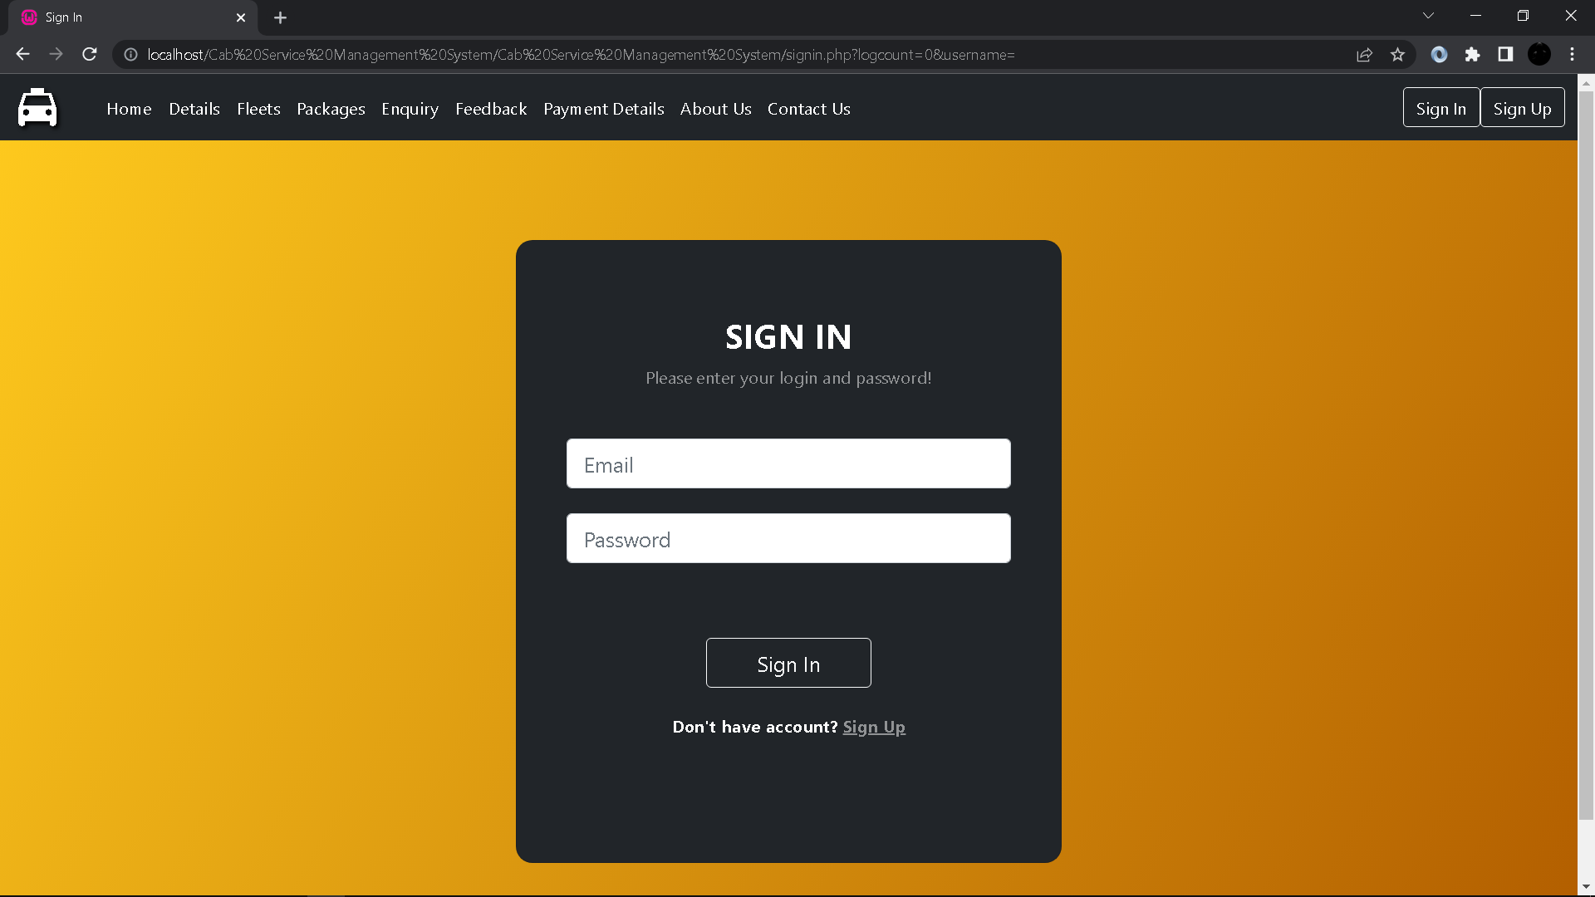
Sign In:

Slide 22
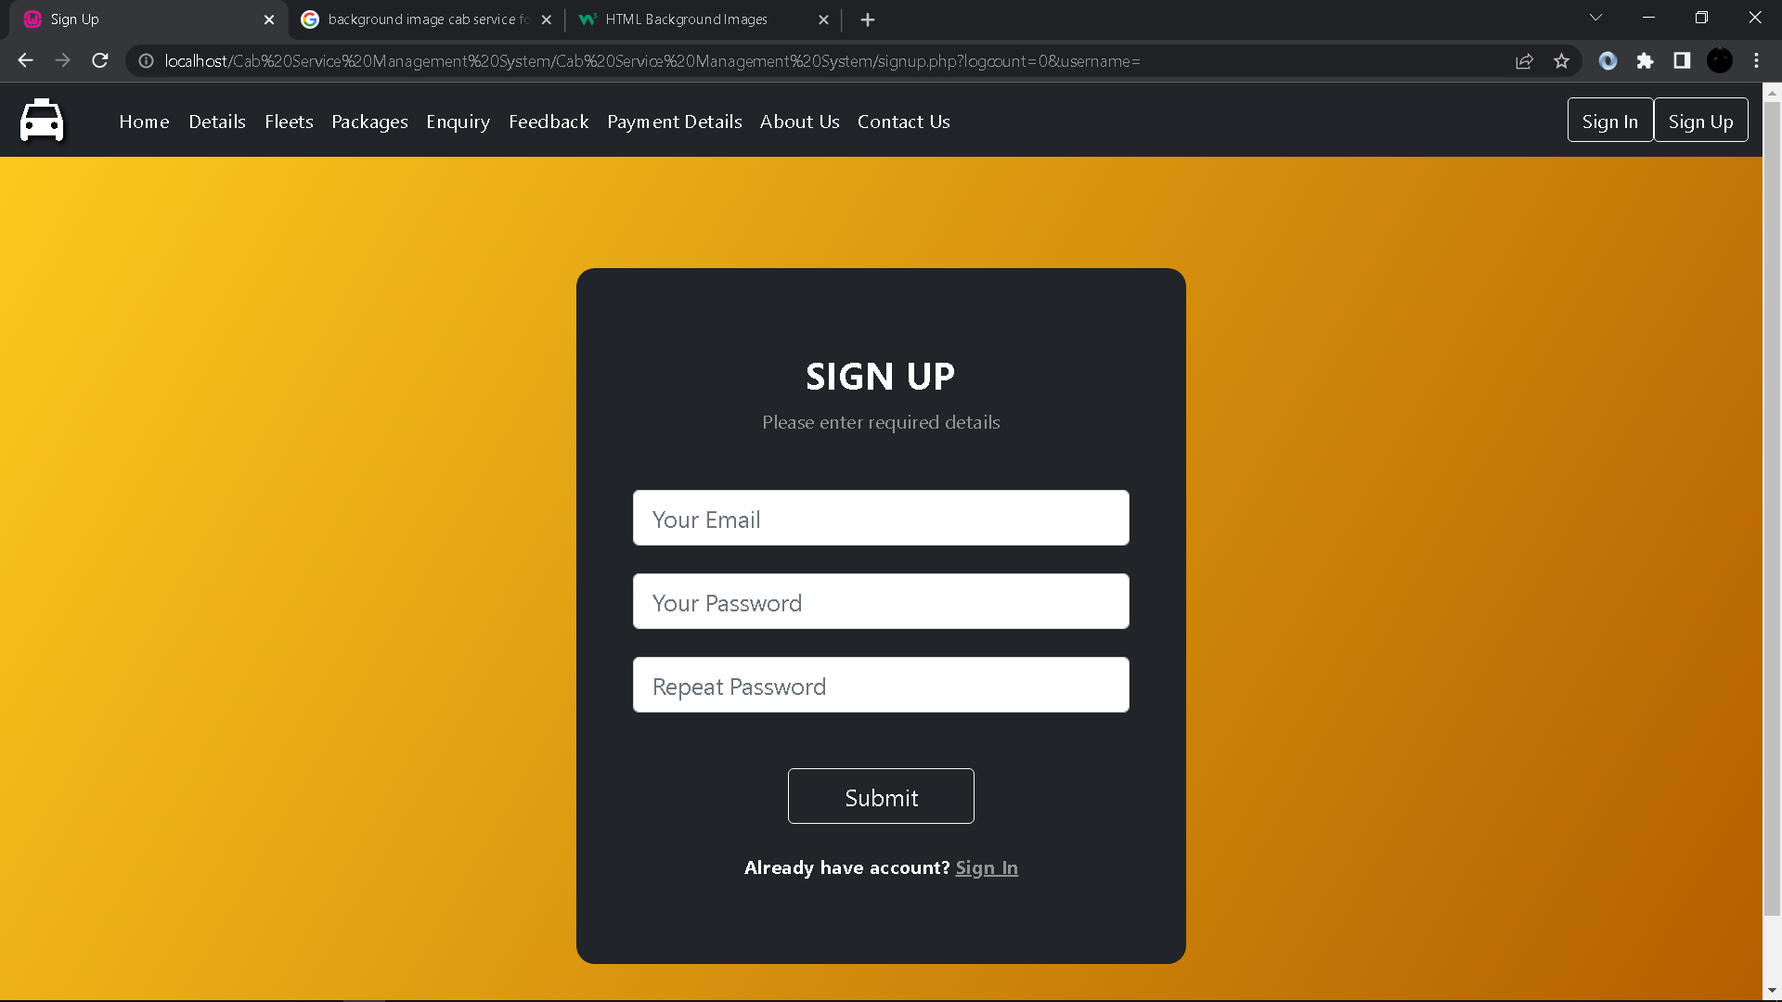
Sign Up:

Slide 23
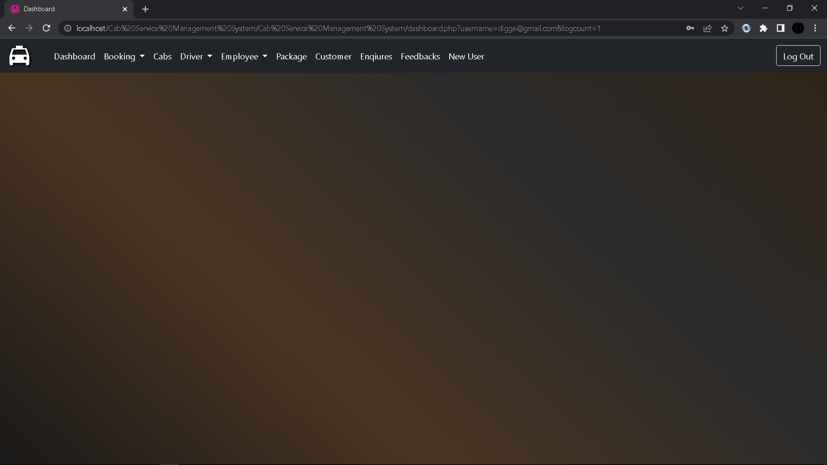
Dashboard:

Slide 24
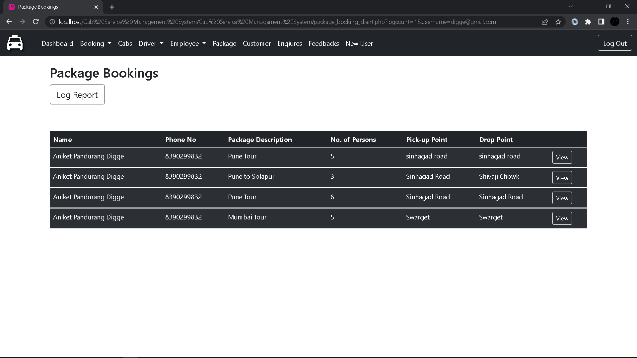
Package Booking(Client Side):

Slide 25
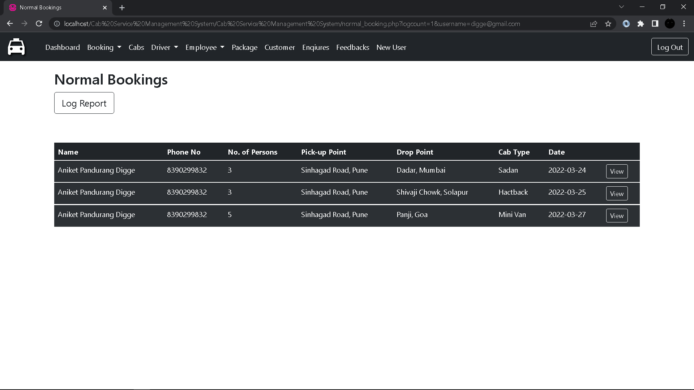
Normal Booking(Client Side):

Slide 26
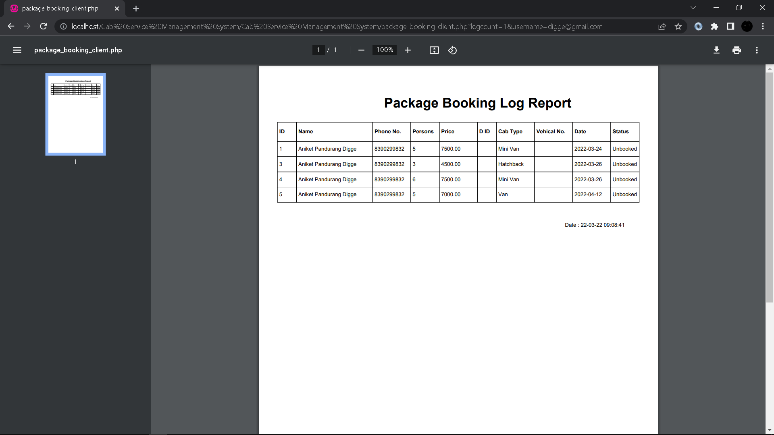
Package Booking Log Report:

Slide 27
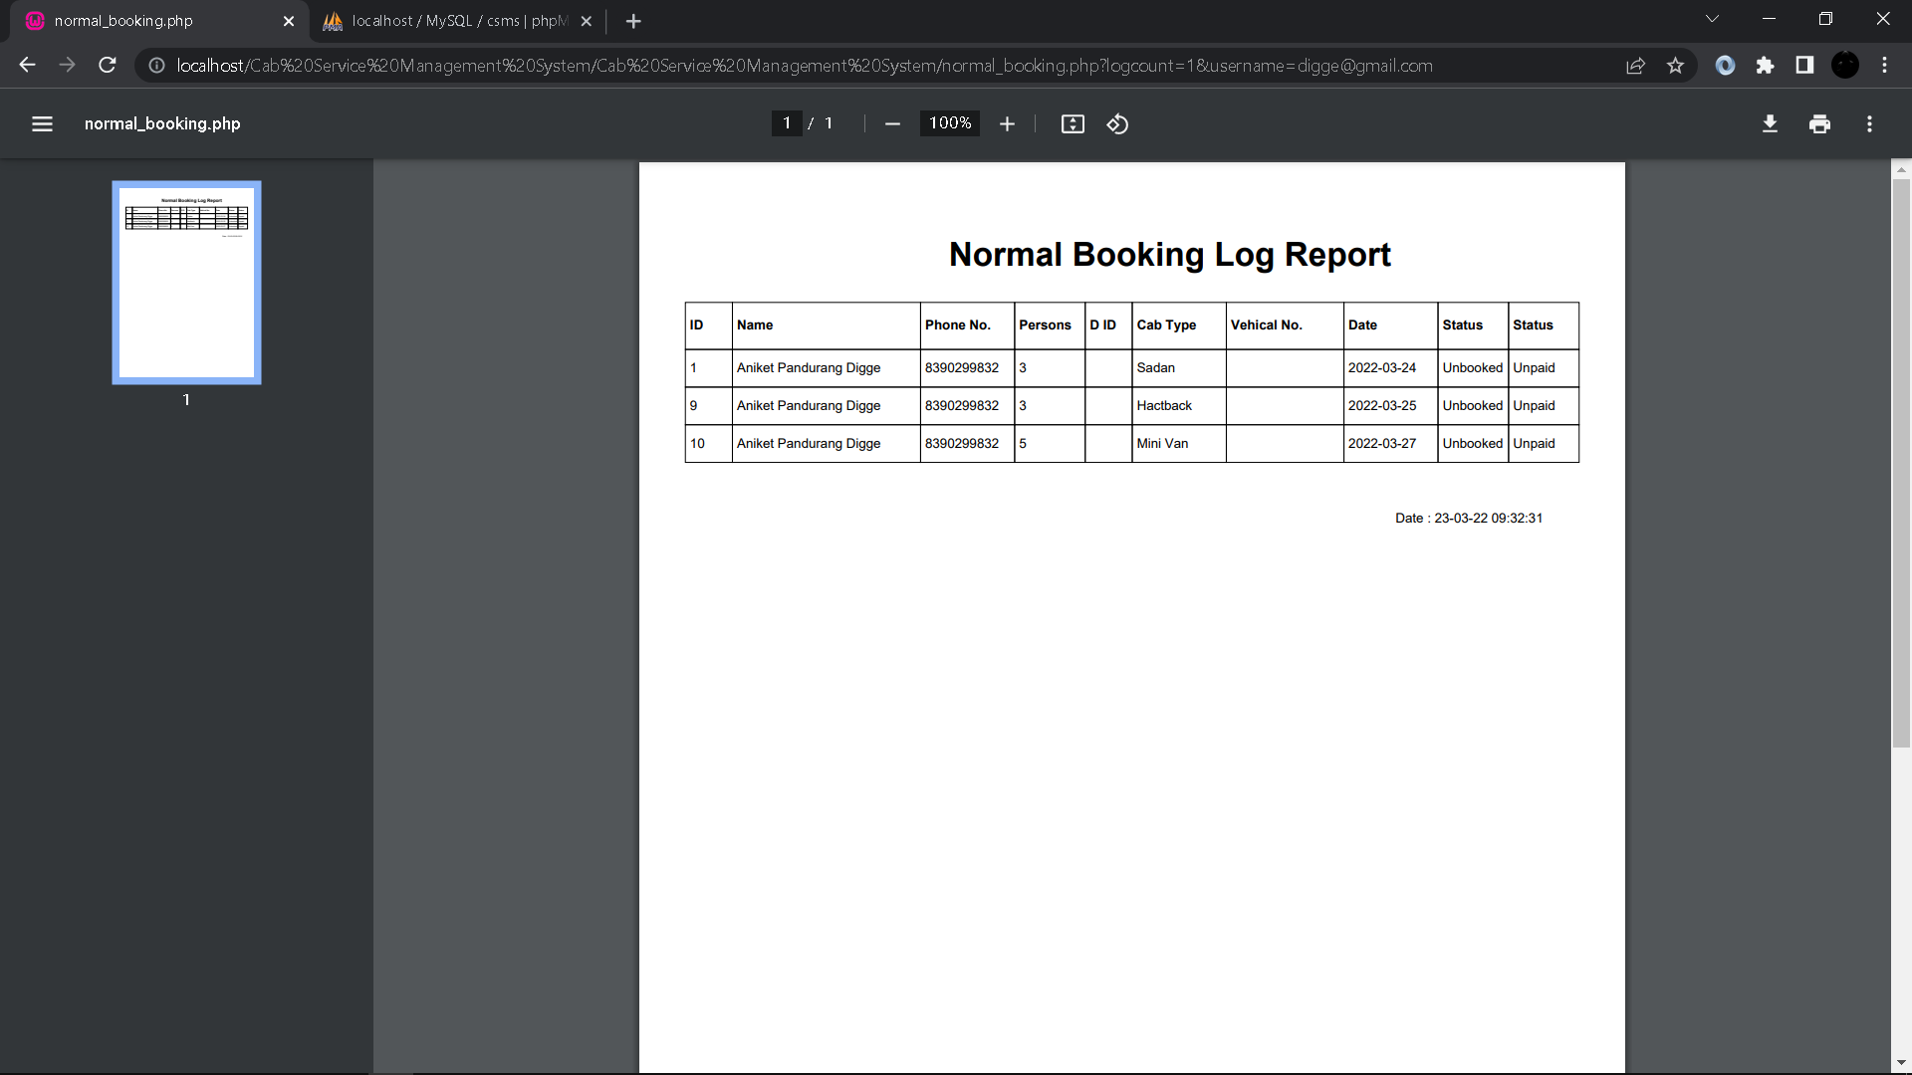
Normal Booking Log Report:

Slide 28
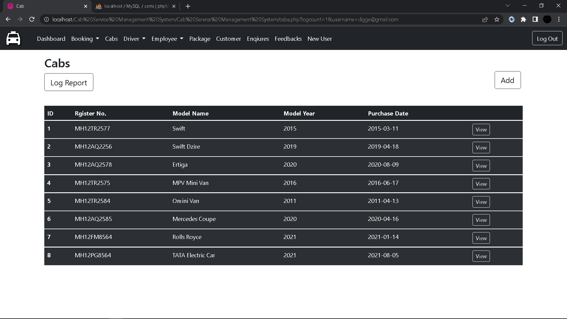
Cabs:

Slide 29
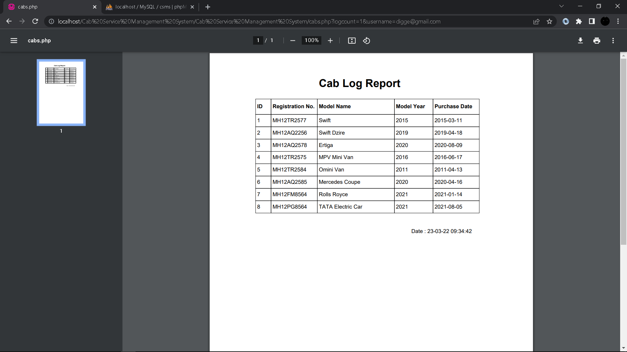
Cab Log Report:

Slide 30
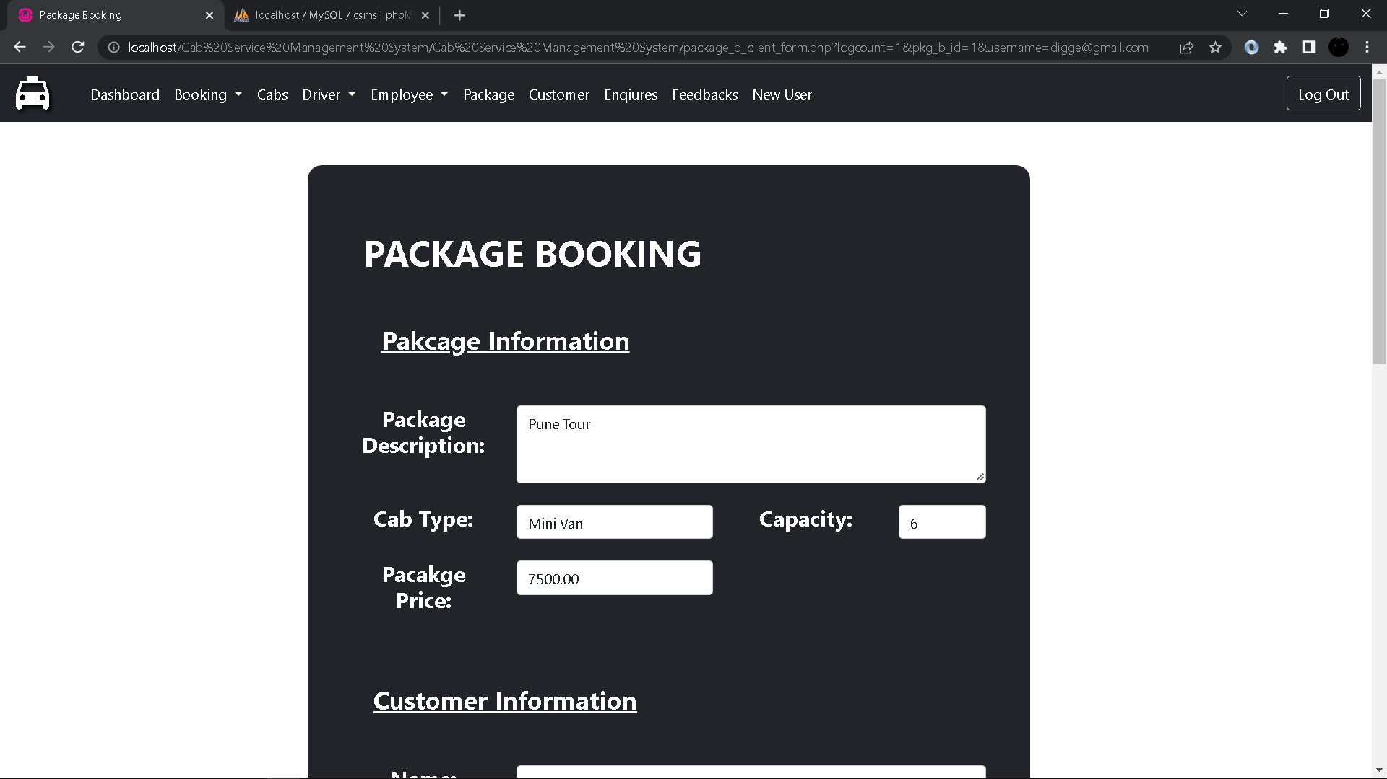
Package Booking Form:

Slide 31
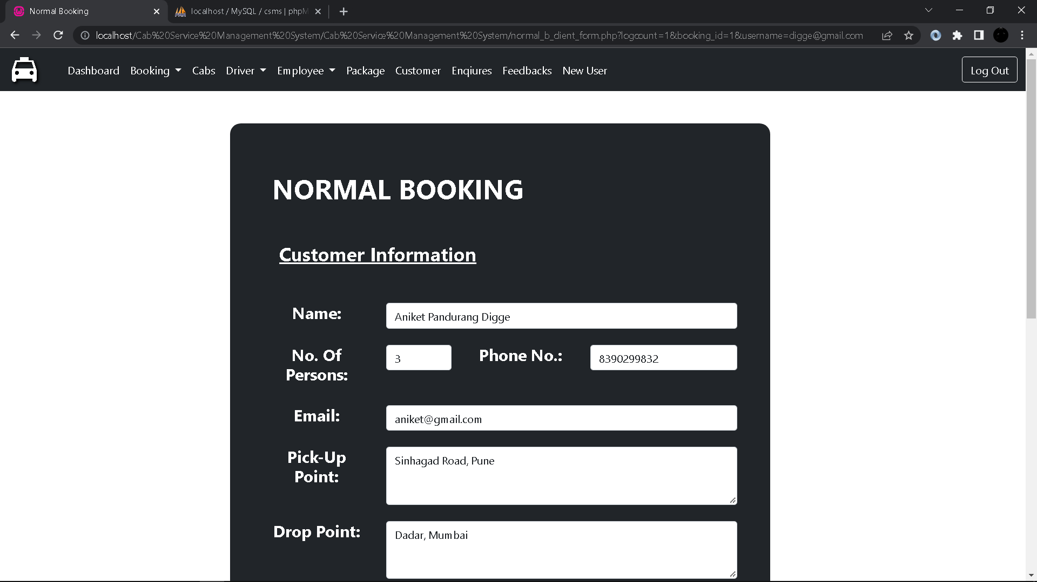
Normal Booking Form:

Slide 32
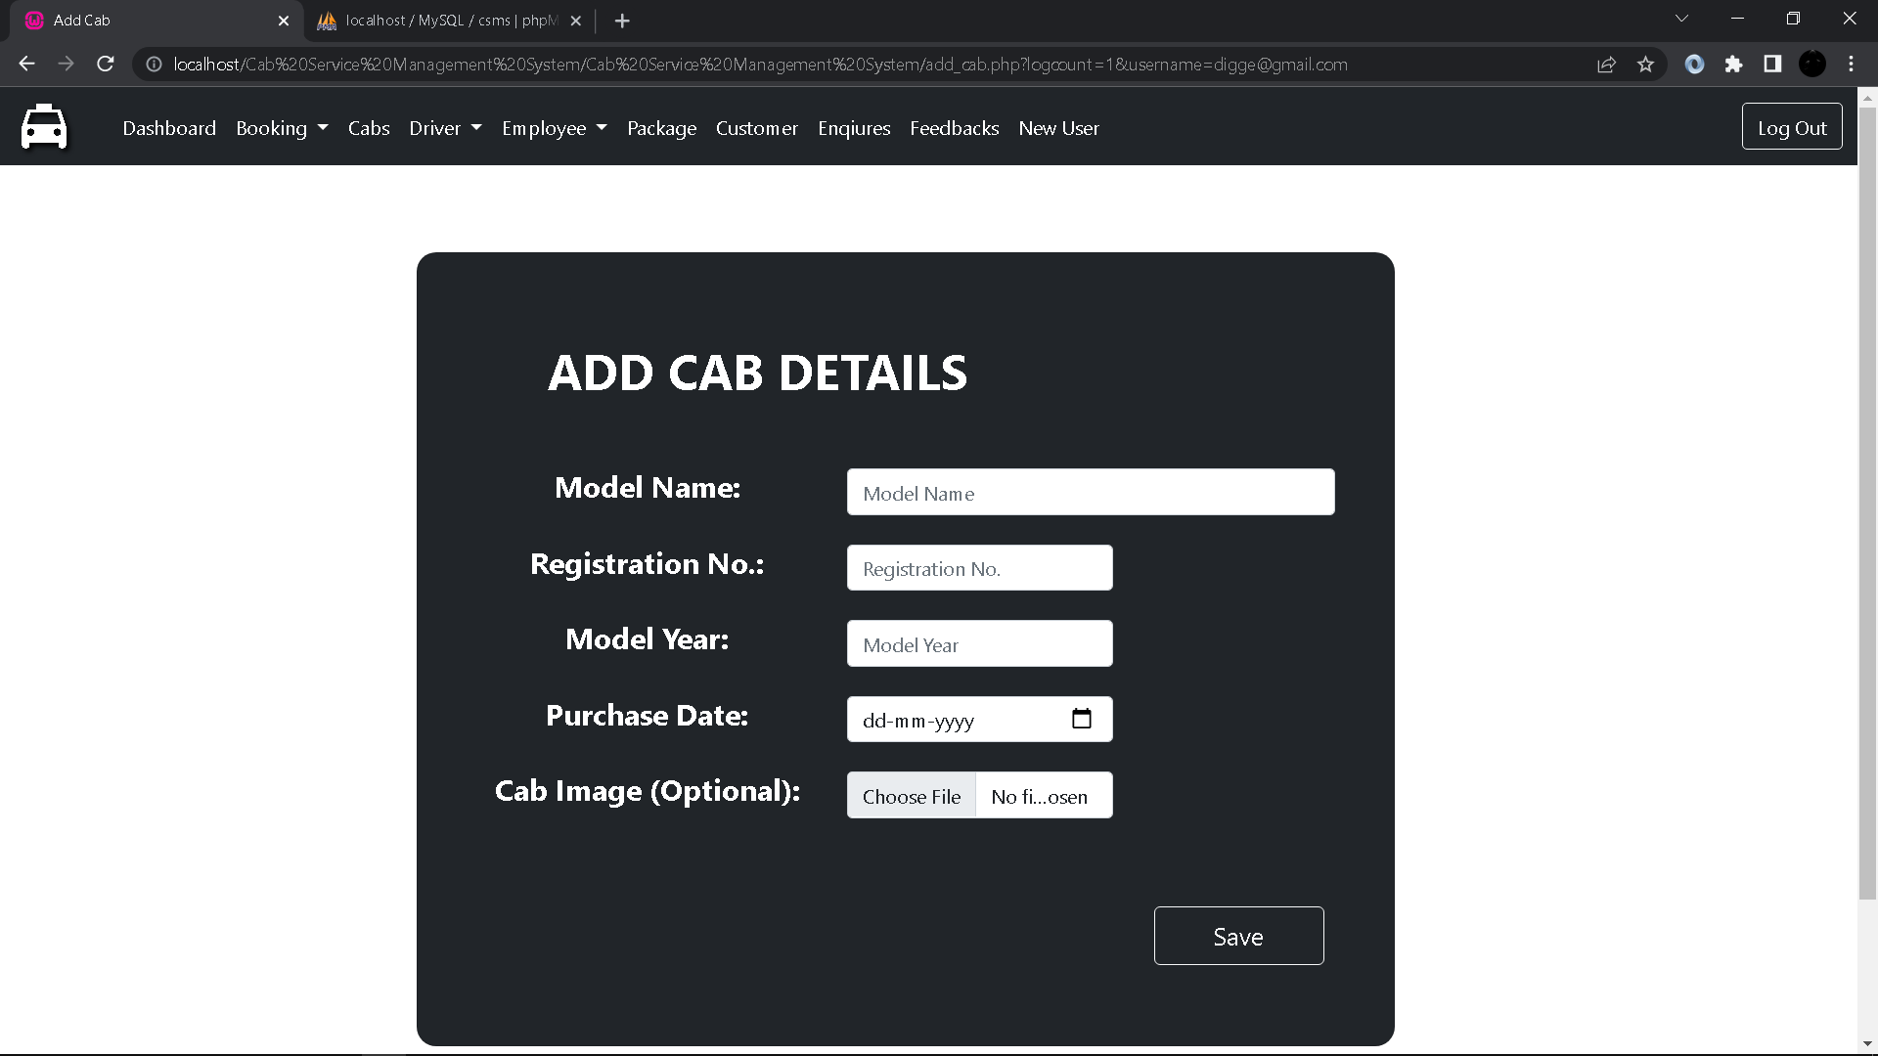
Add Cab Details From:

Slide 33
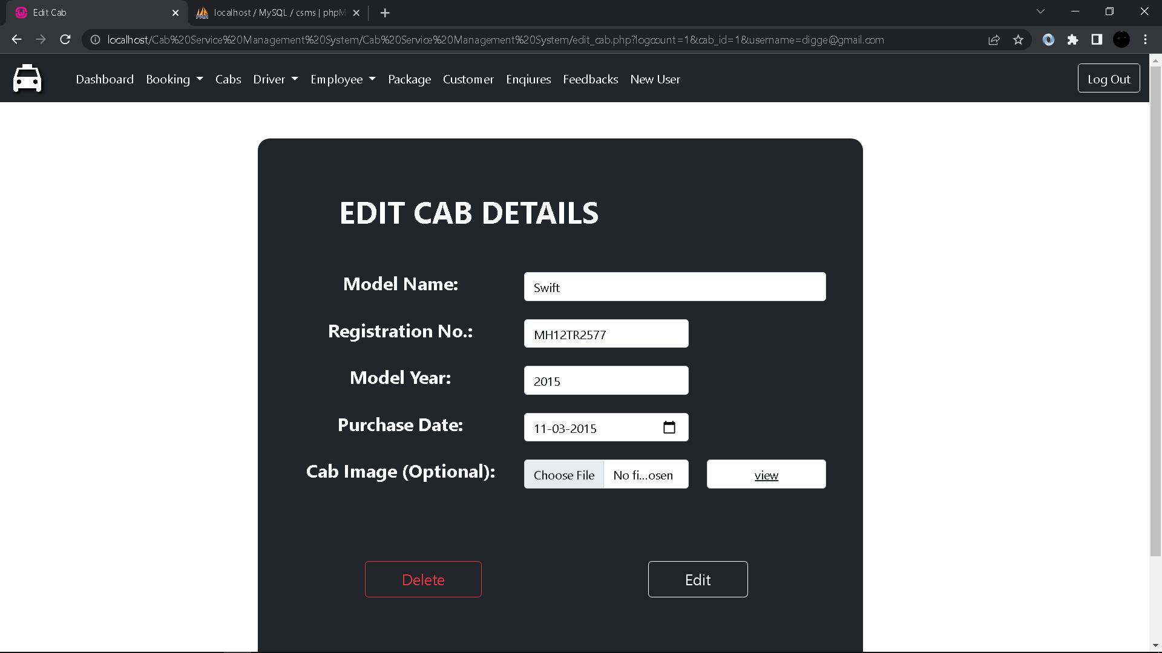
Edit Cab Details Form:

Slide 34
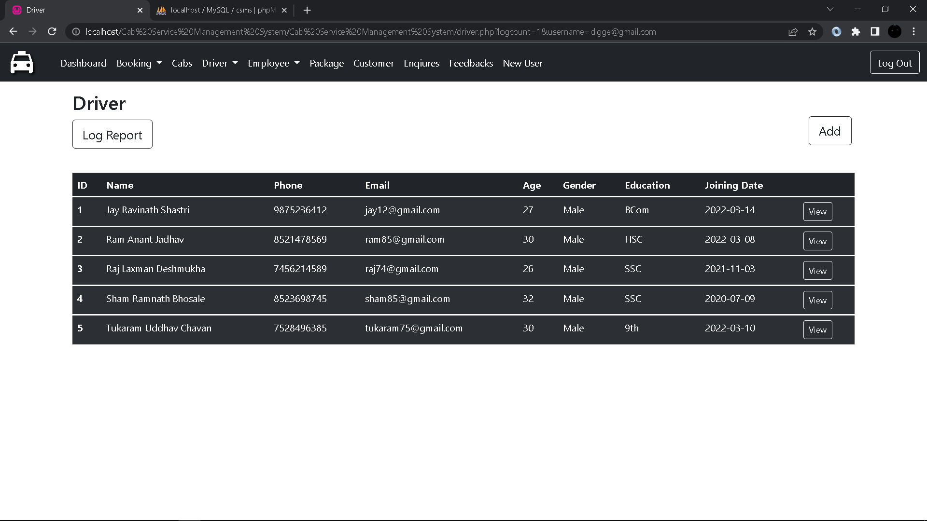
Driver:

Slide 35
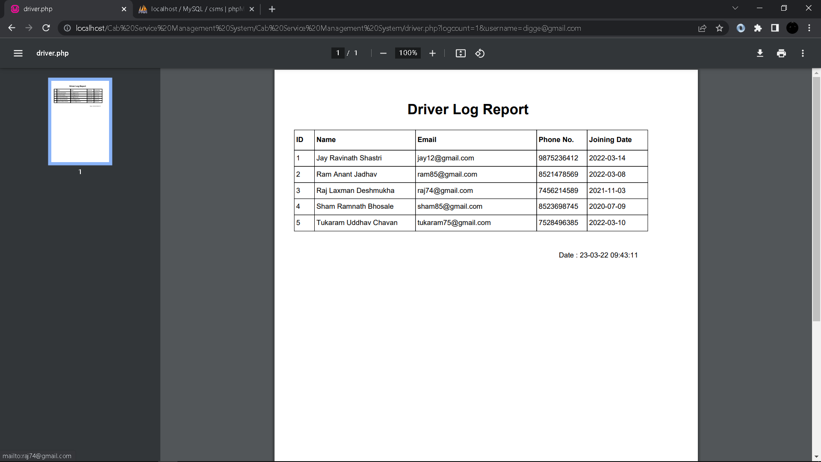
Driver Log Report:

Slide 36
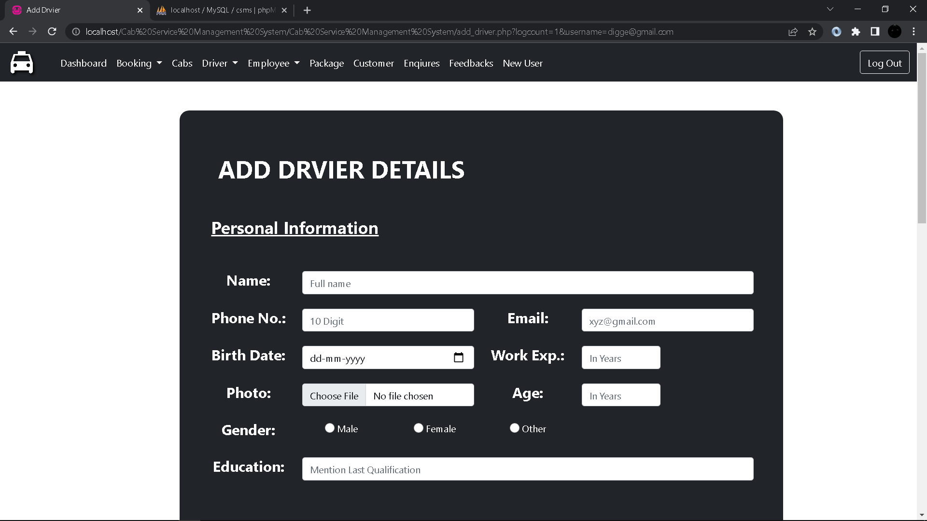
Add Driver Details Form:

Slide 37
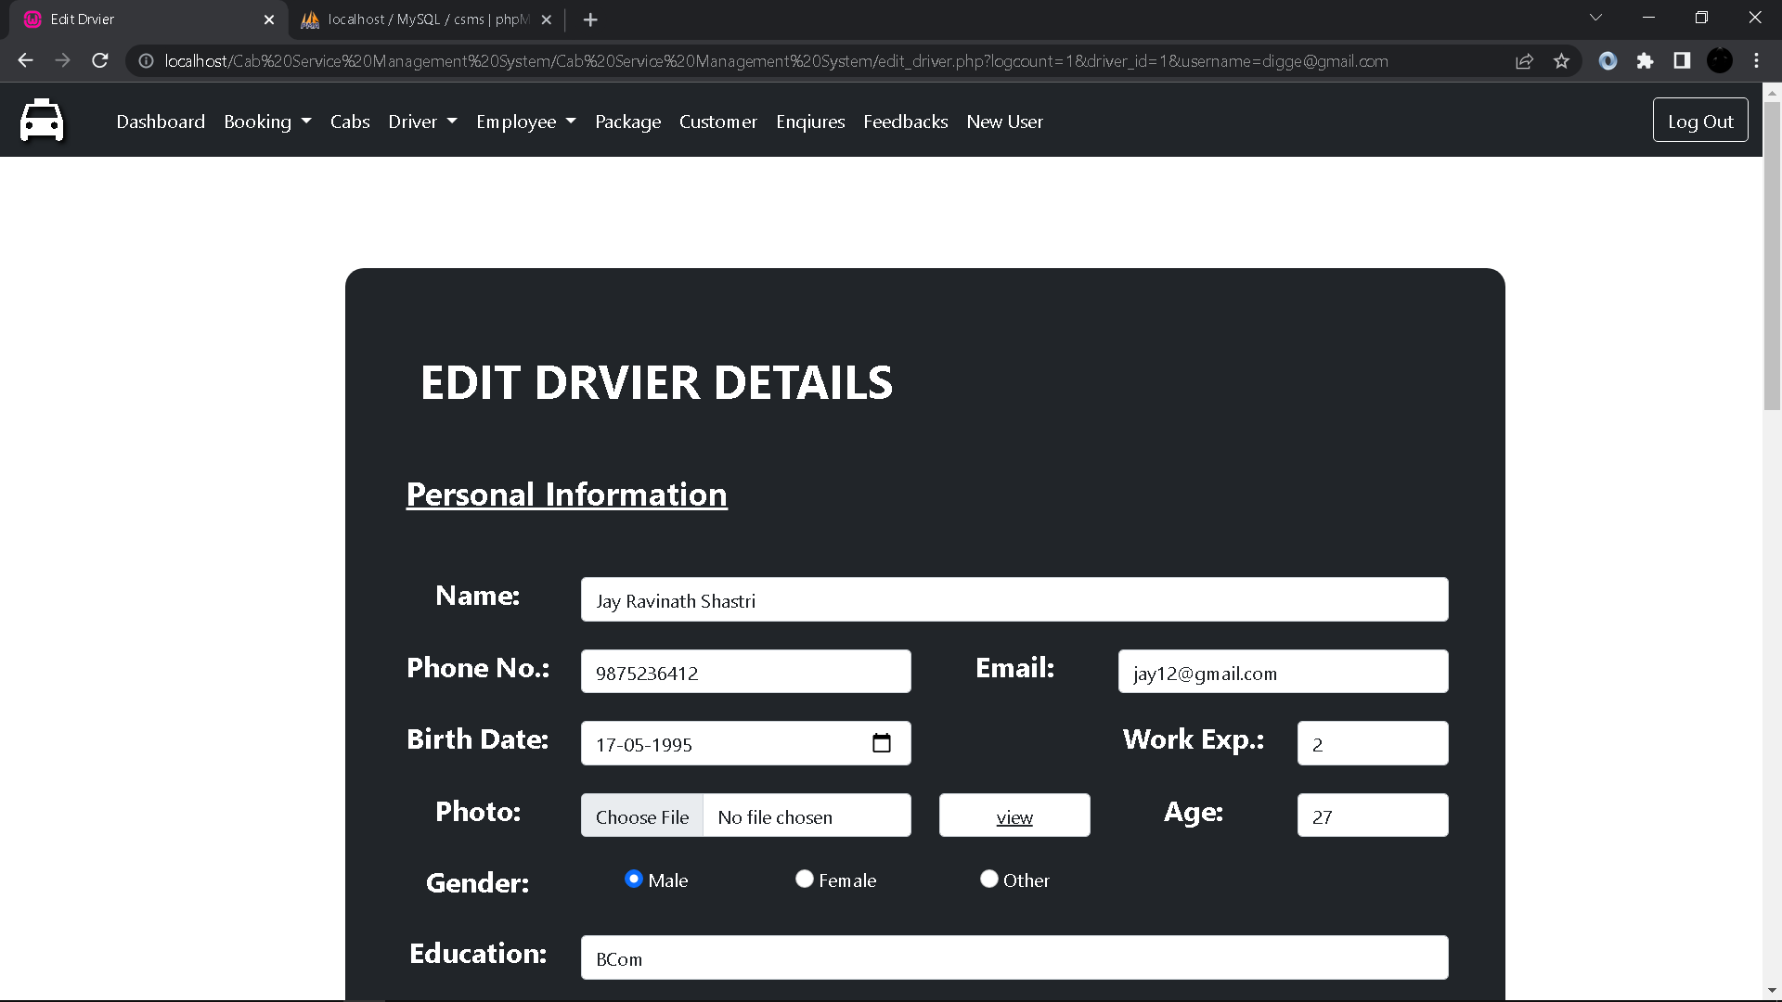
Edit Driver Details Form:

Slide 38
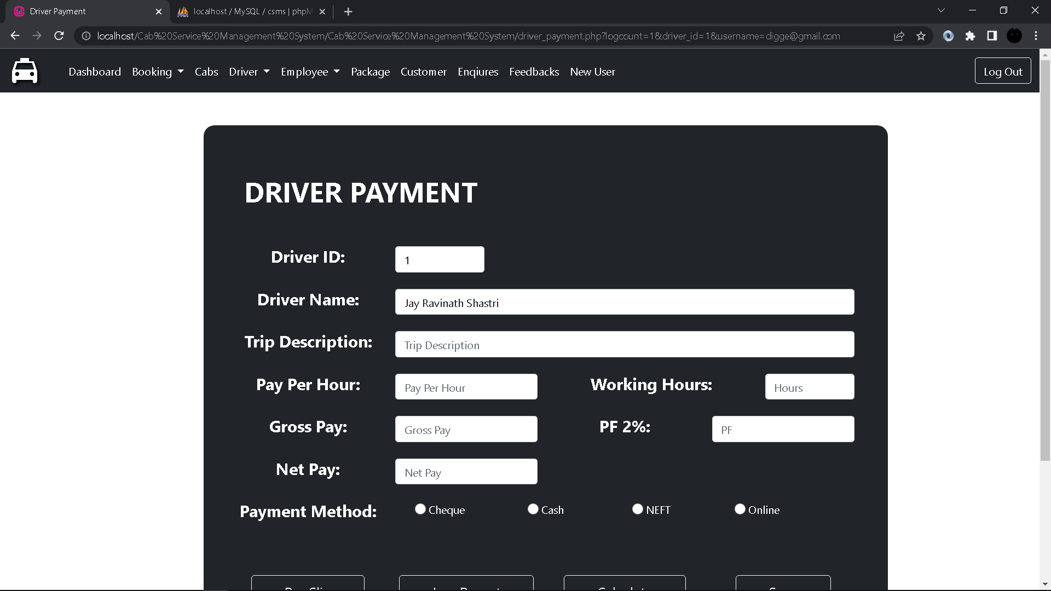
Driver Payment Form:

Slide 39
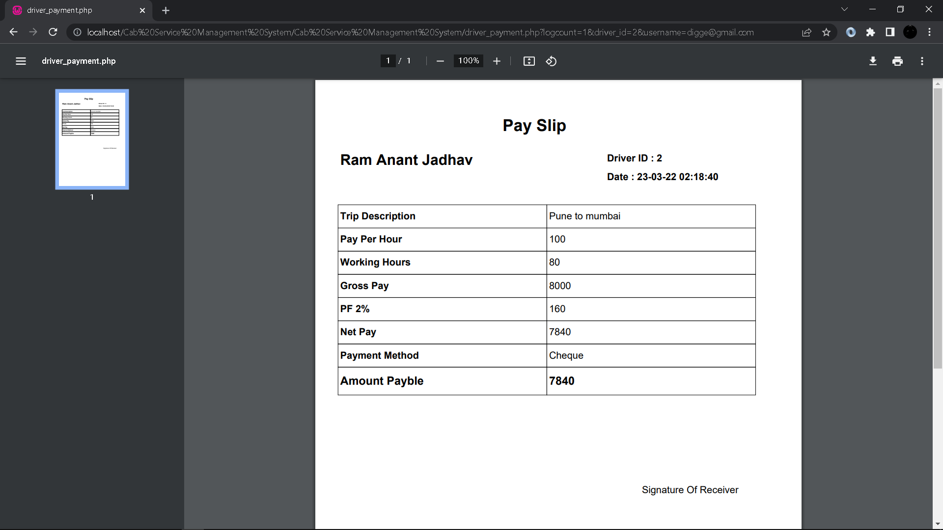
Driver Pay Slip:

Slide 40
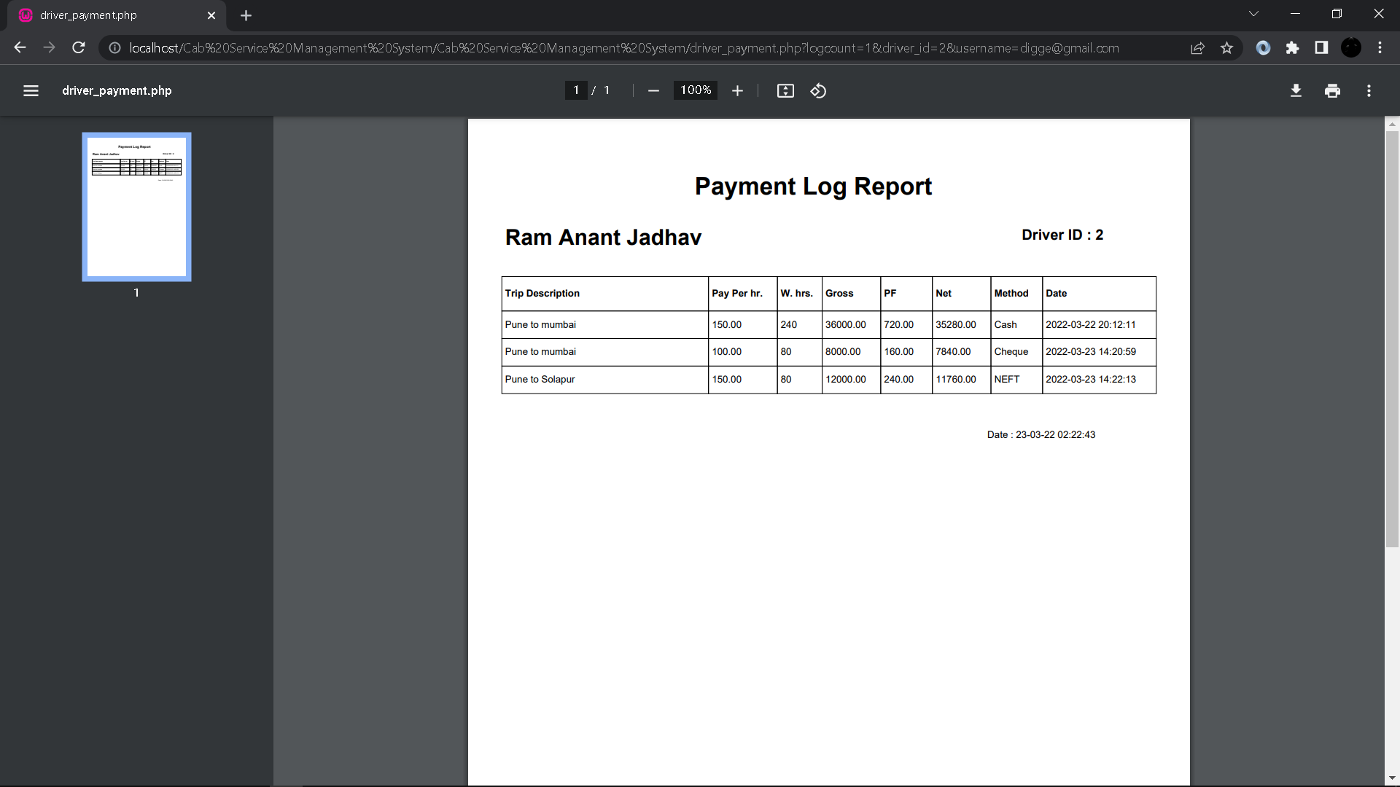
Driver Payment Log Report:

Slide 41
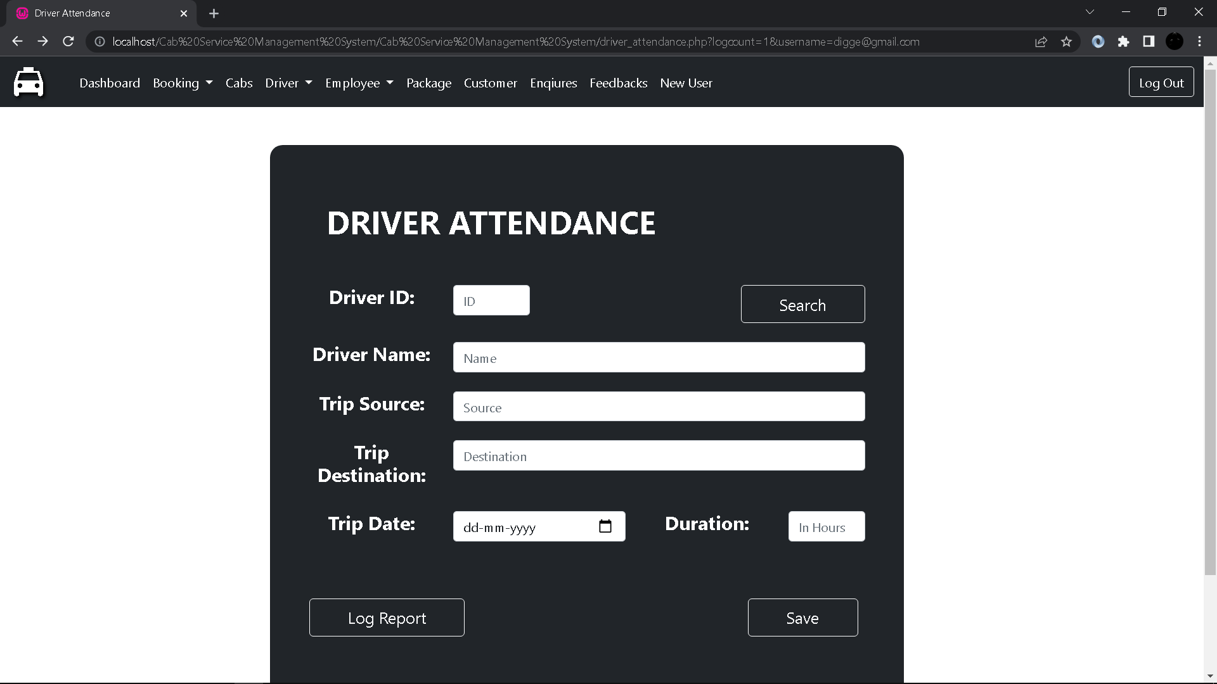
Driver Attendance:

Slide 42
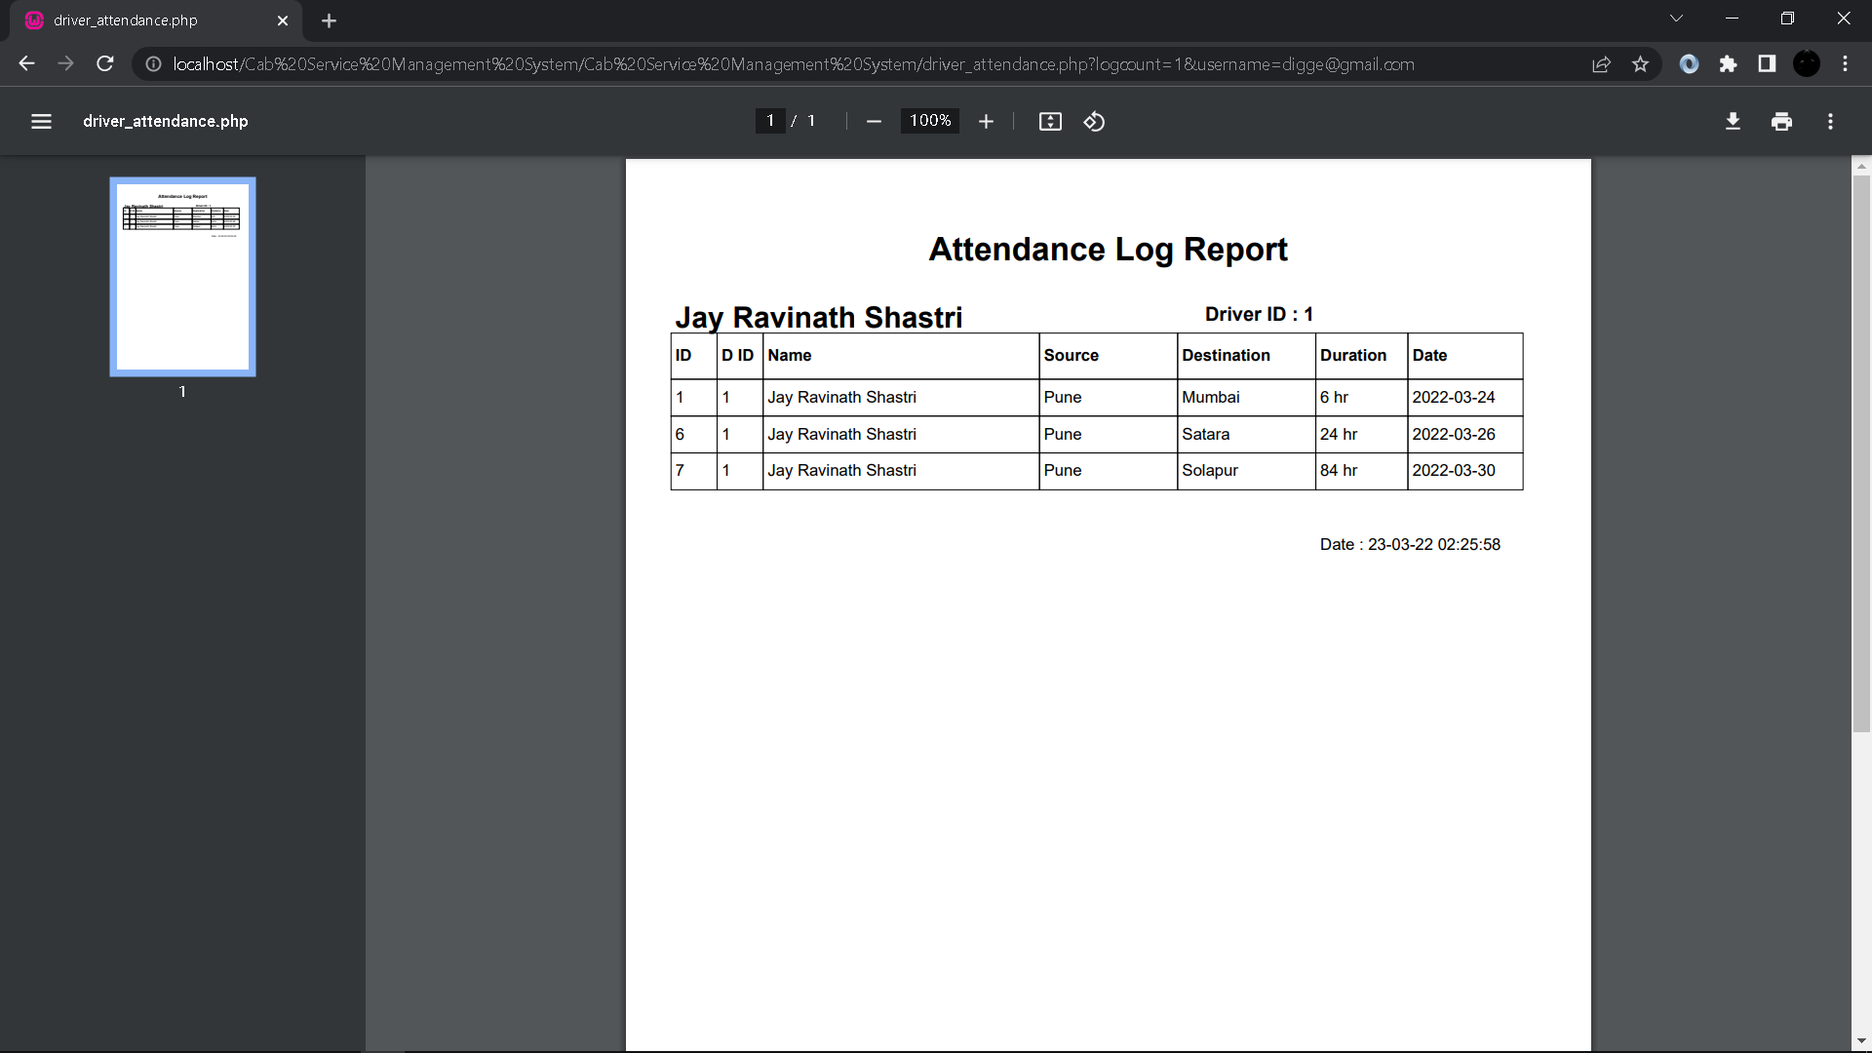
Driver Attendance Log Report:

Slide 43
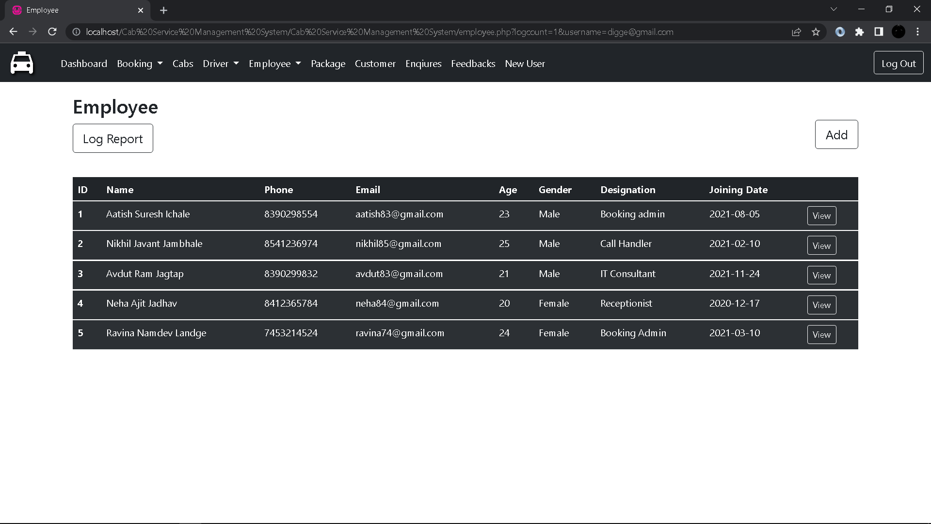
Employee:

Slide 44

Employee Log Report:

Slide 45
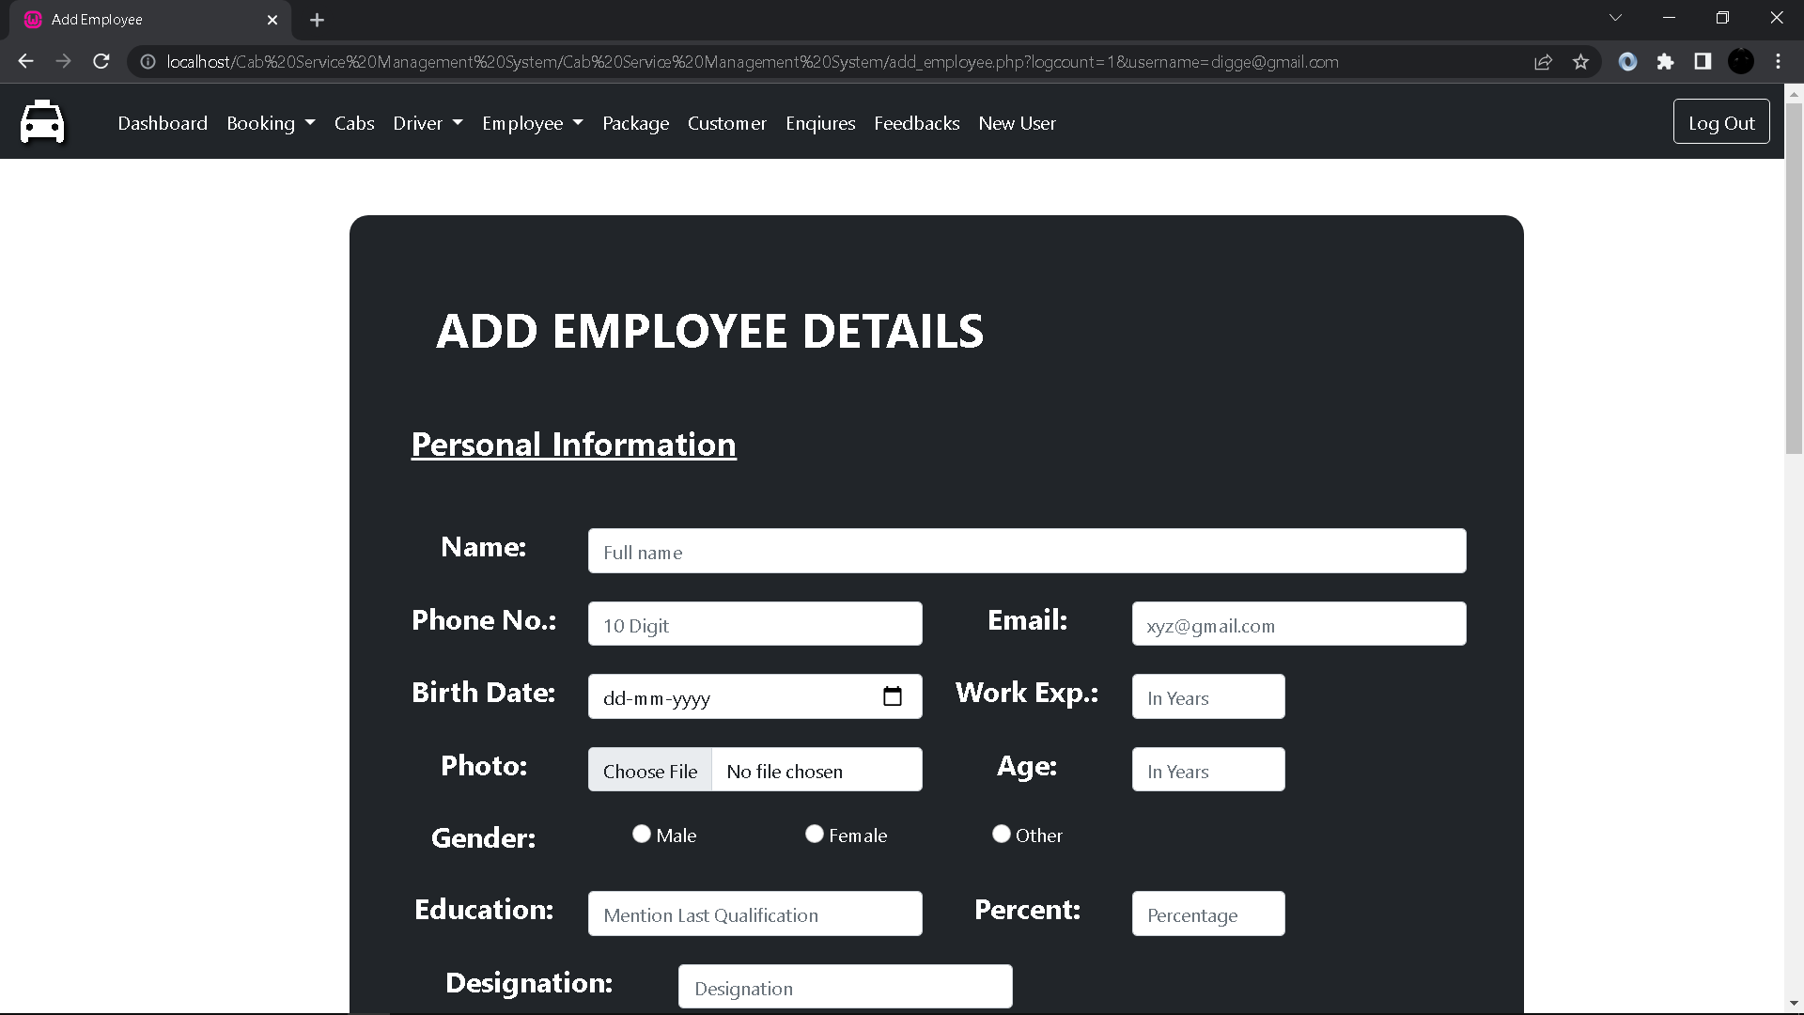
Add Employee Details Form:

Slide 46
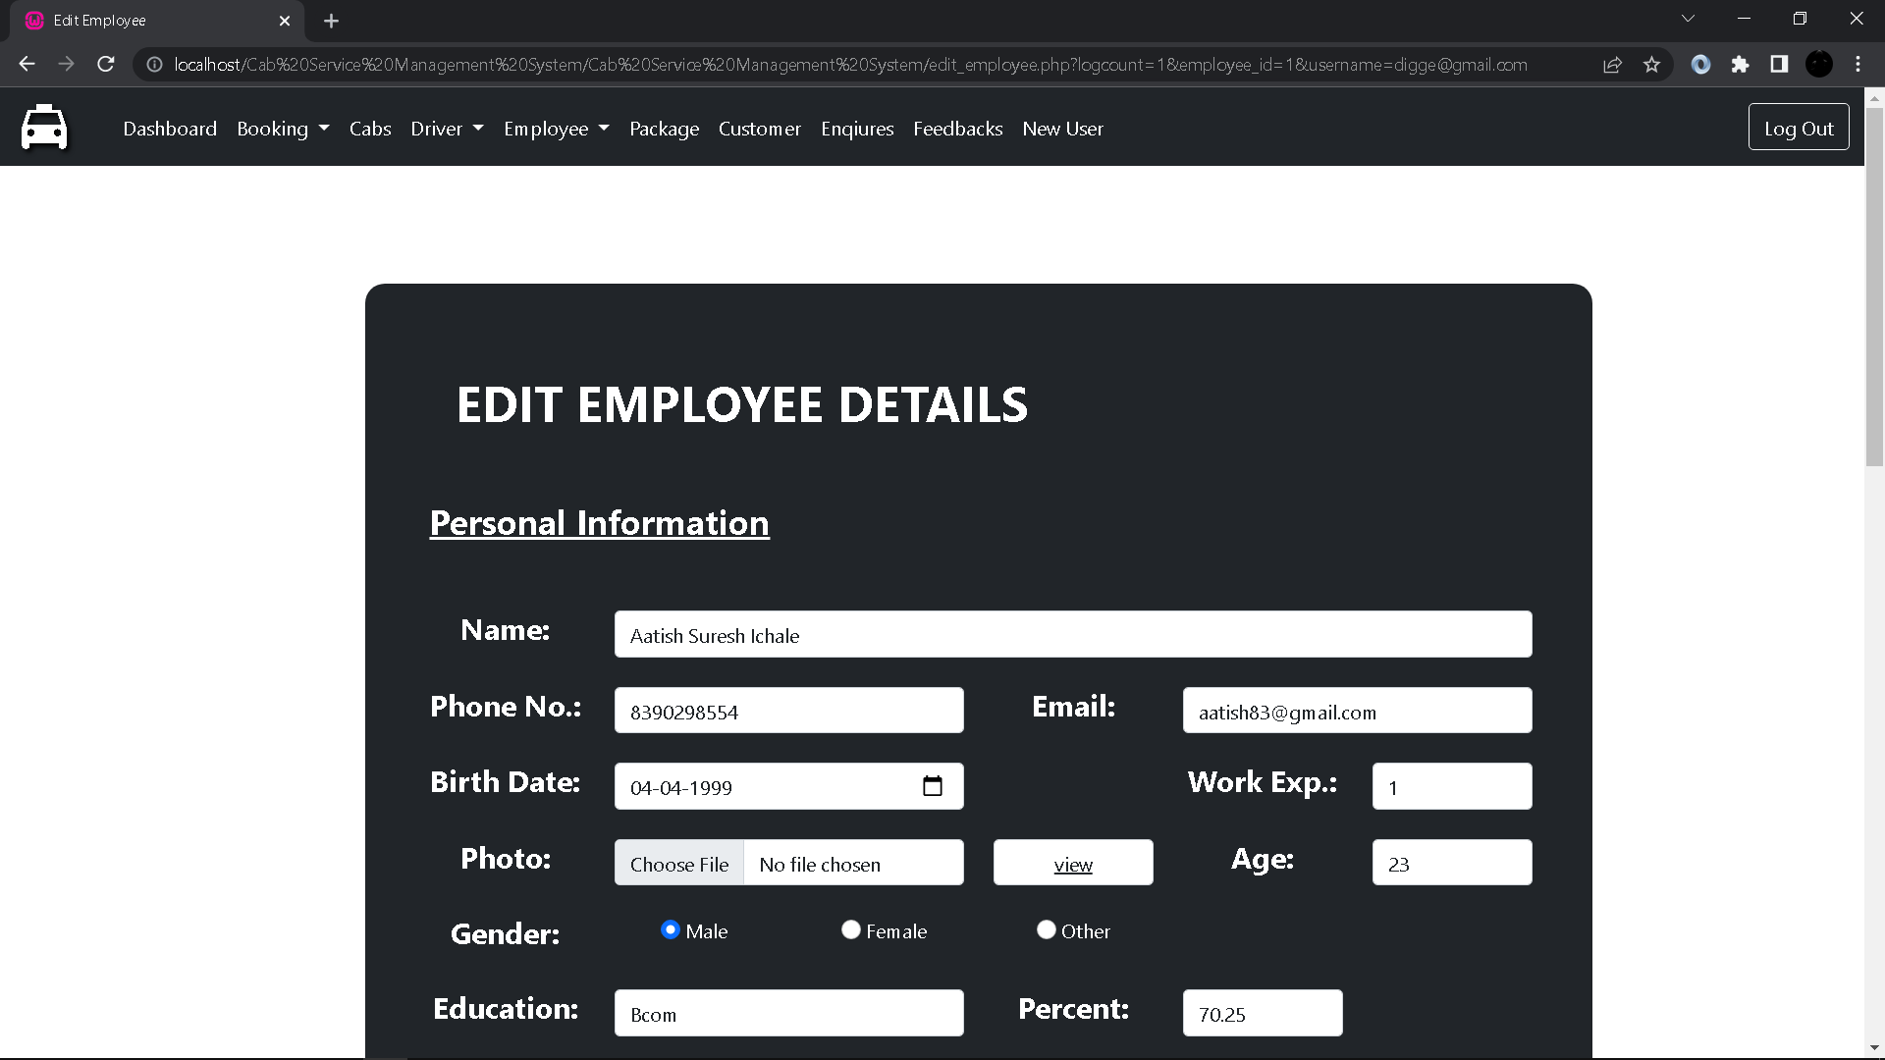
Edit Employee Details Form:

Slide 47
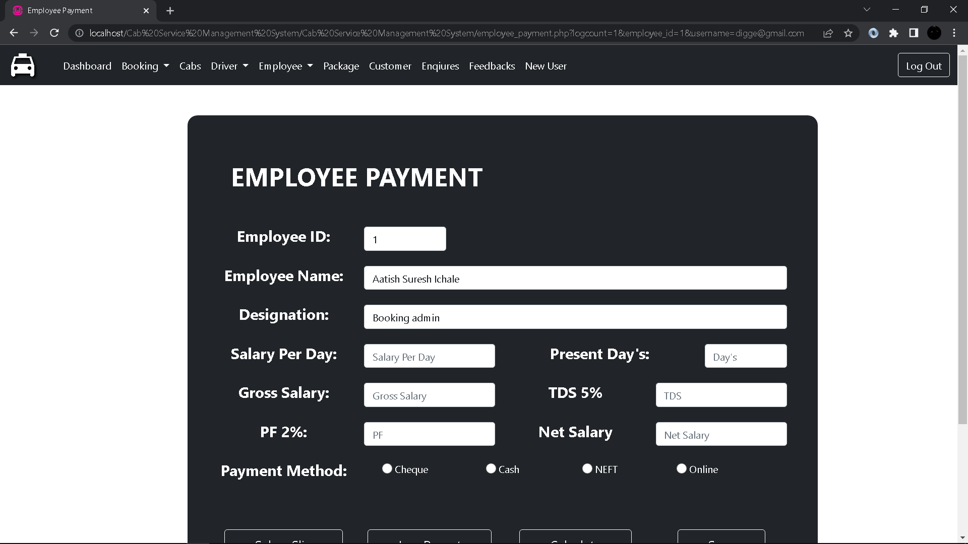
Employee Payment Form:

Slide 48
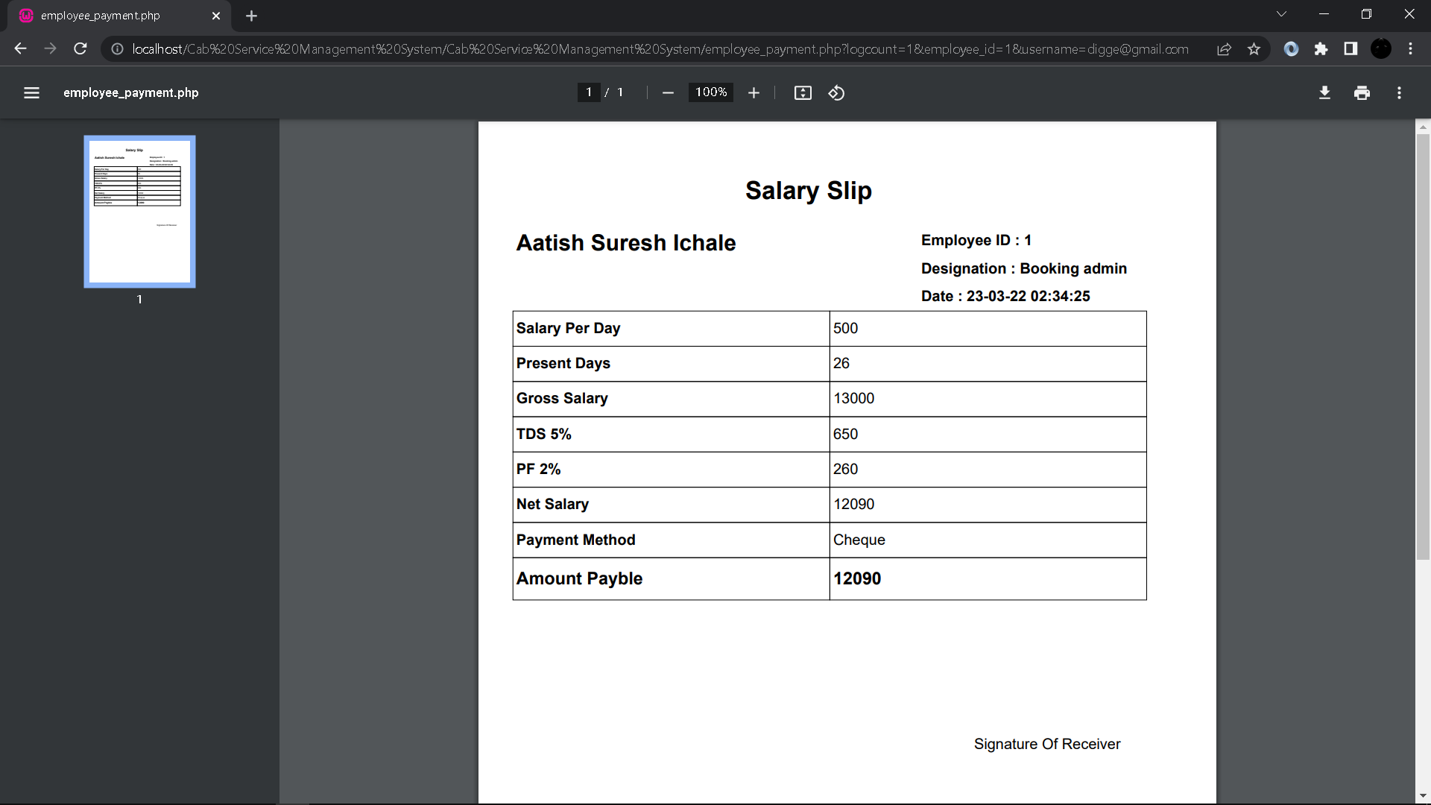
Employee Salary Slip:

Slide 49
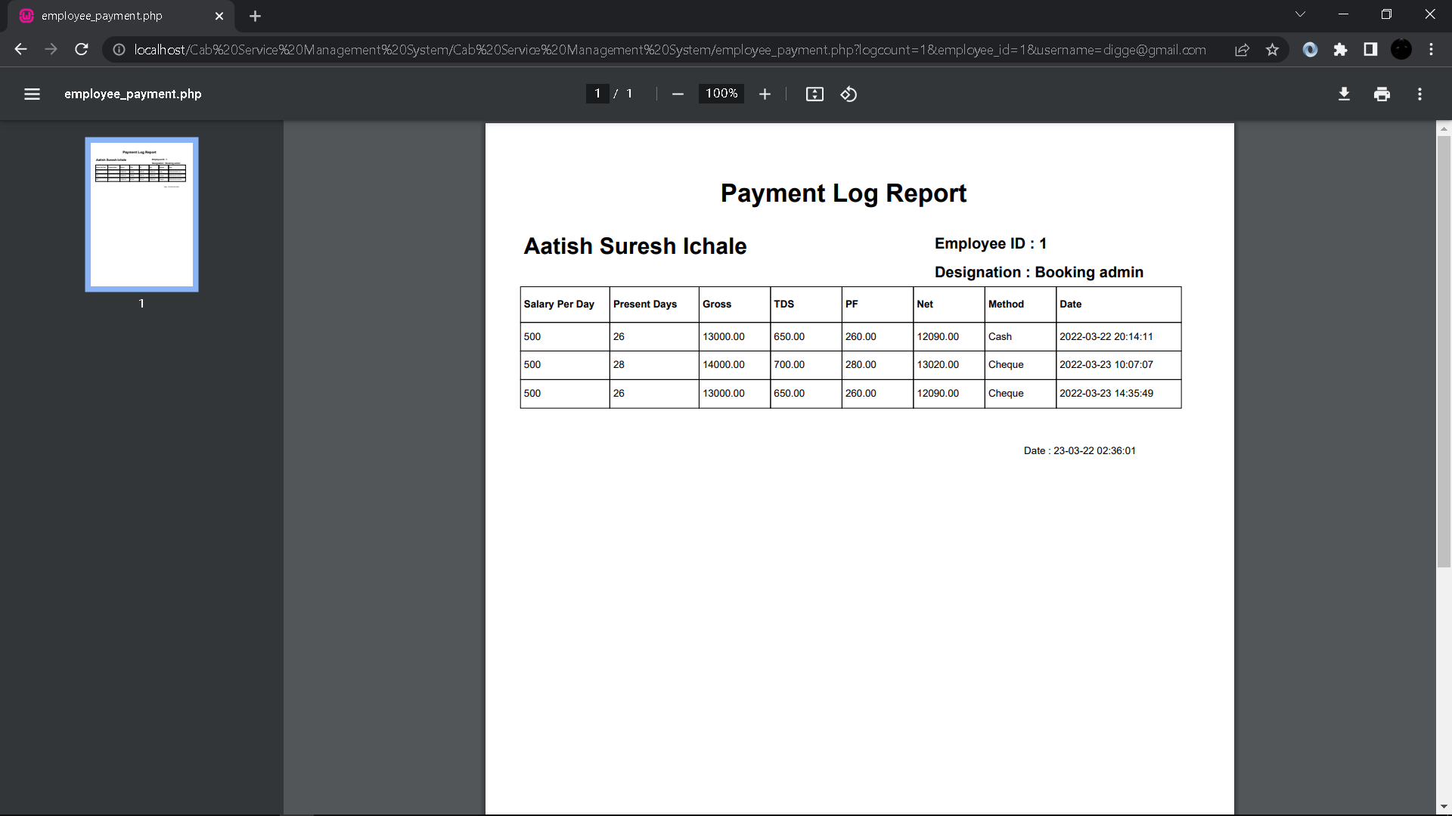
Employee Payment Log Report:

Slide 50
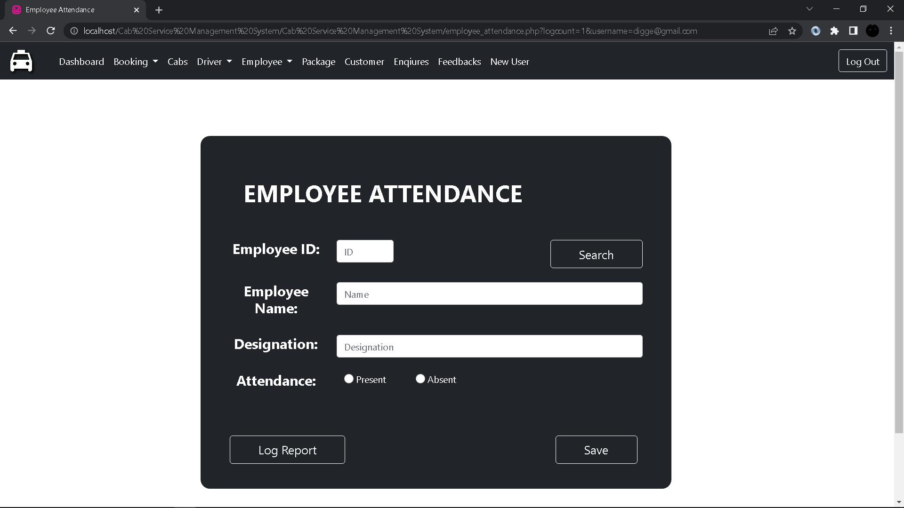
Employee Attendance:

Slide 51
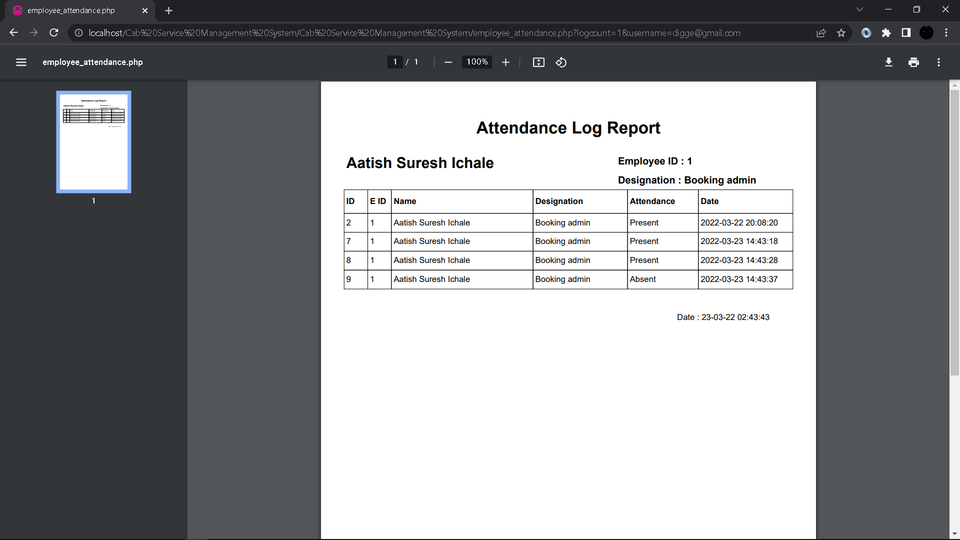
Employee Attendance Log Report:

Slide 52
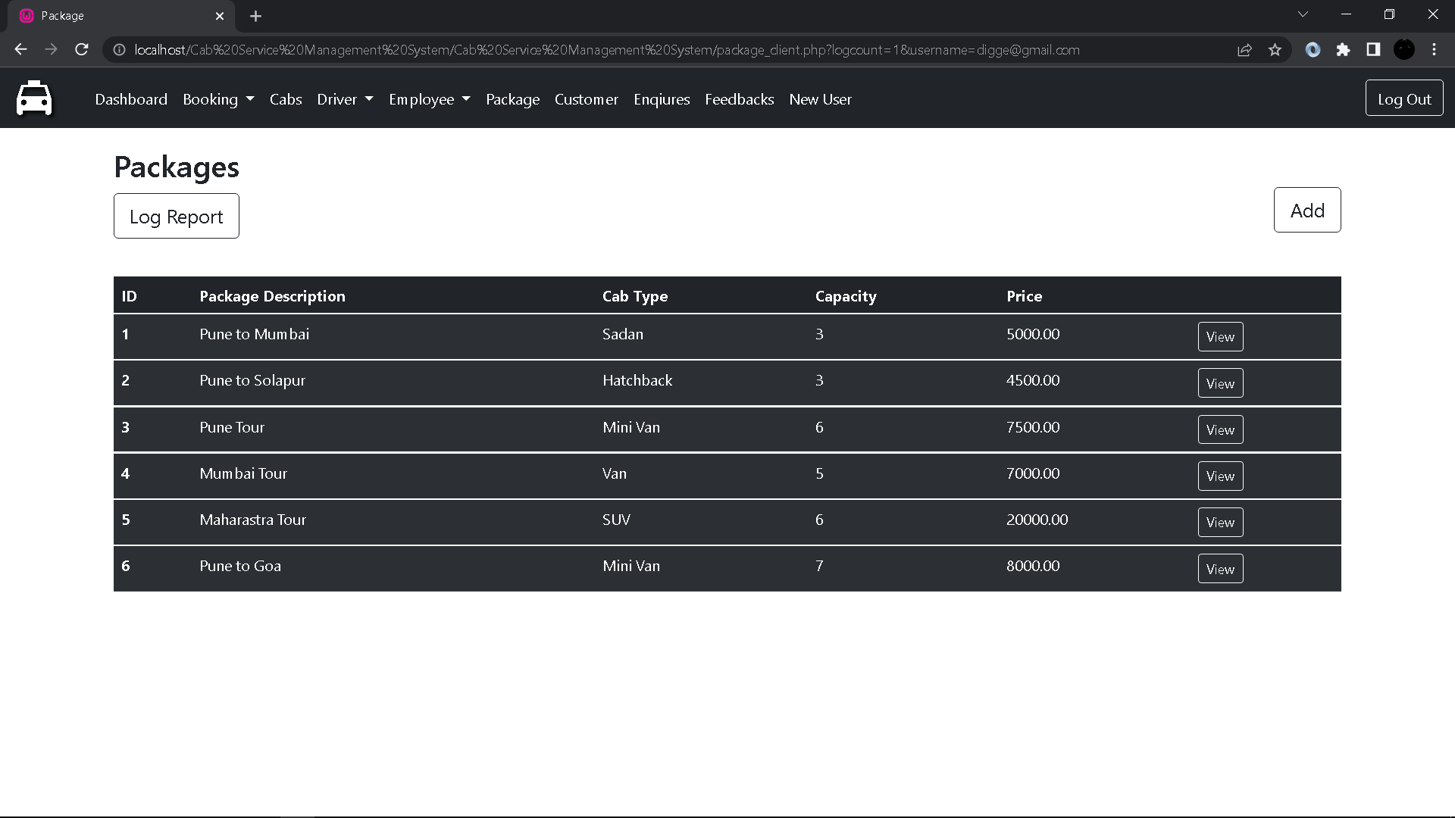
Packages:

Slide 53
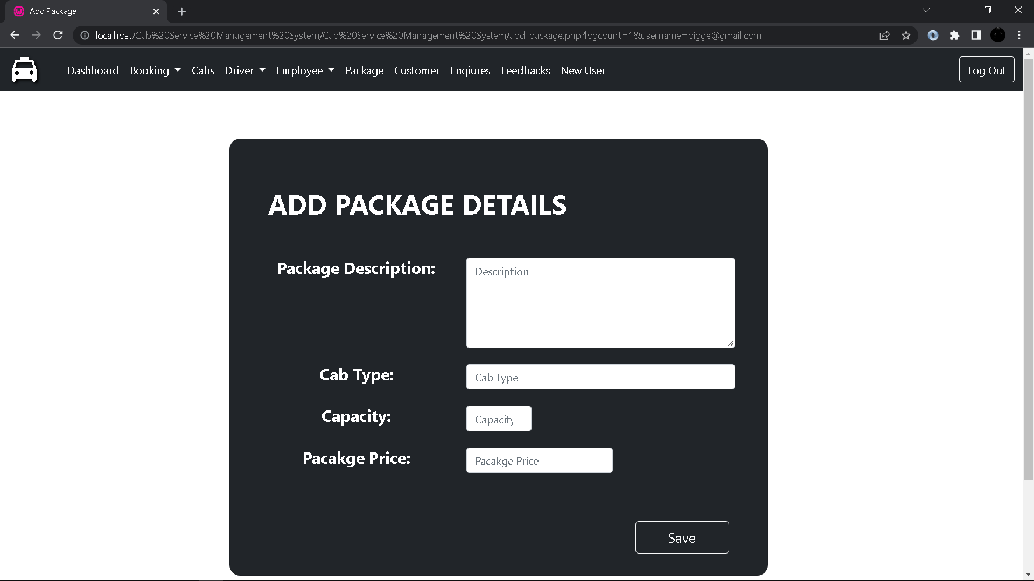
Add Package Details:

Slide 54

Package Log Report:

Slide 55
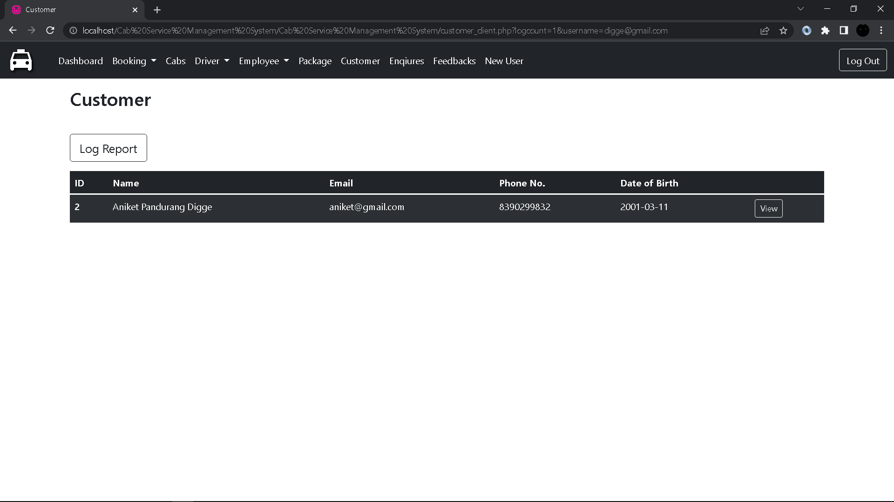
Customer:

Slide 56
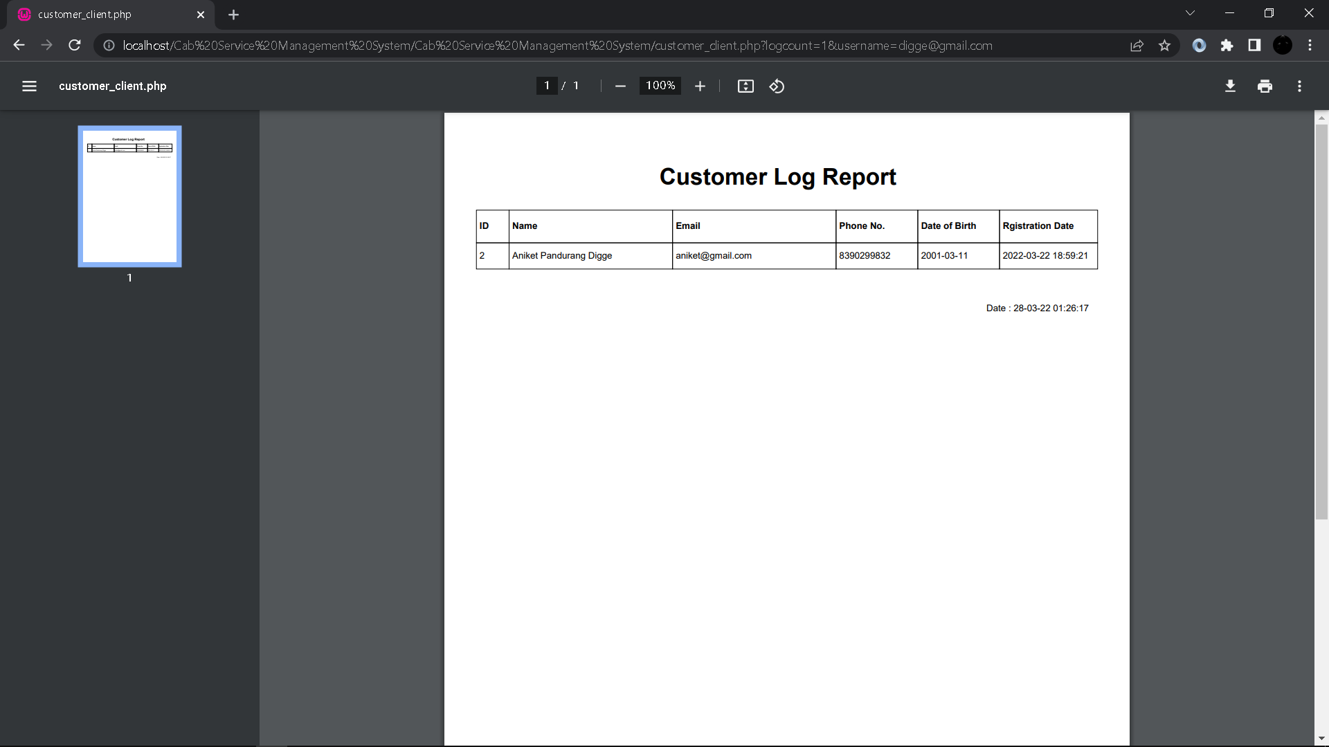
Customer Log Report:

Slide 57
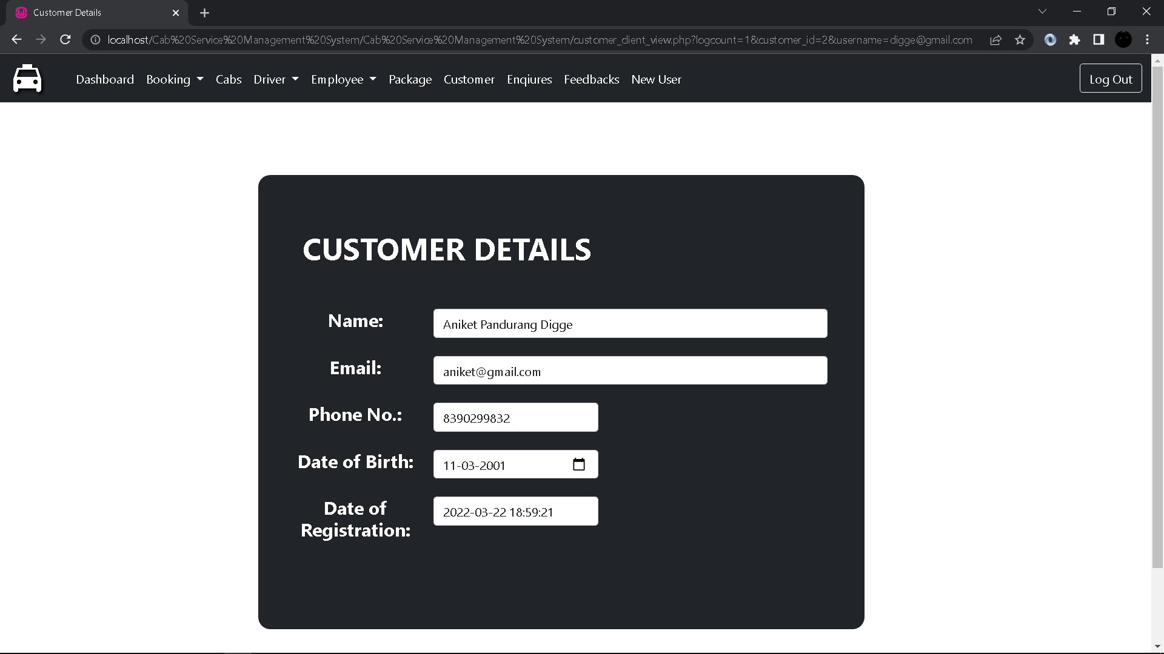
Customer Details(Client Side):

Slide 58
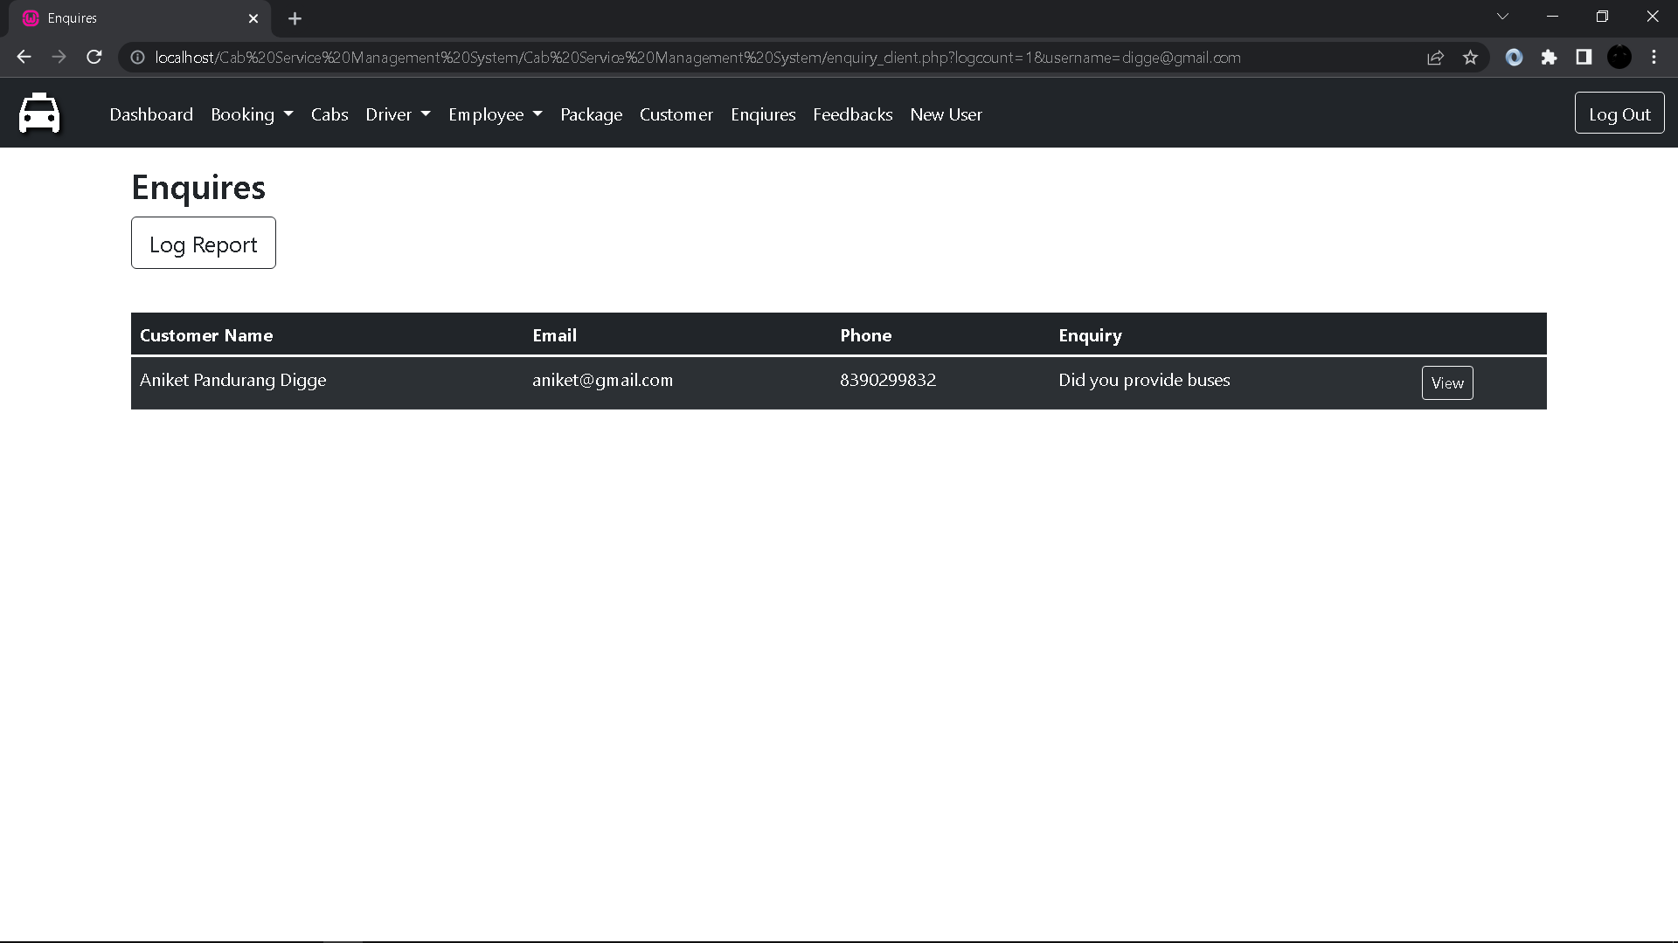
Enquires:

Slide 59

Enquiry Log Report:

Slide 60
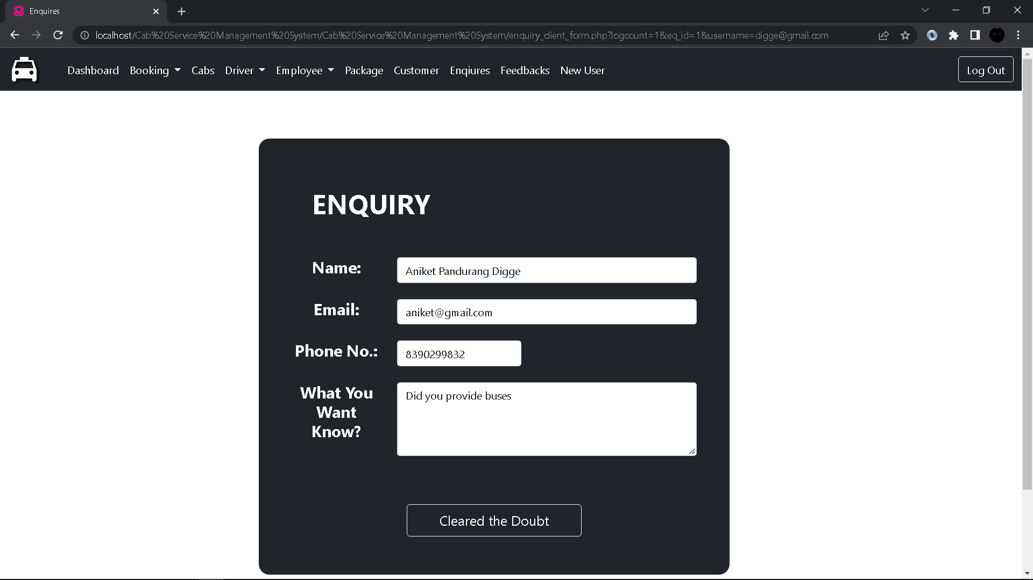
Enquiry Detail Form(Client Side):

Slide 61
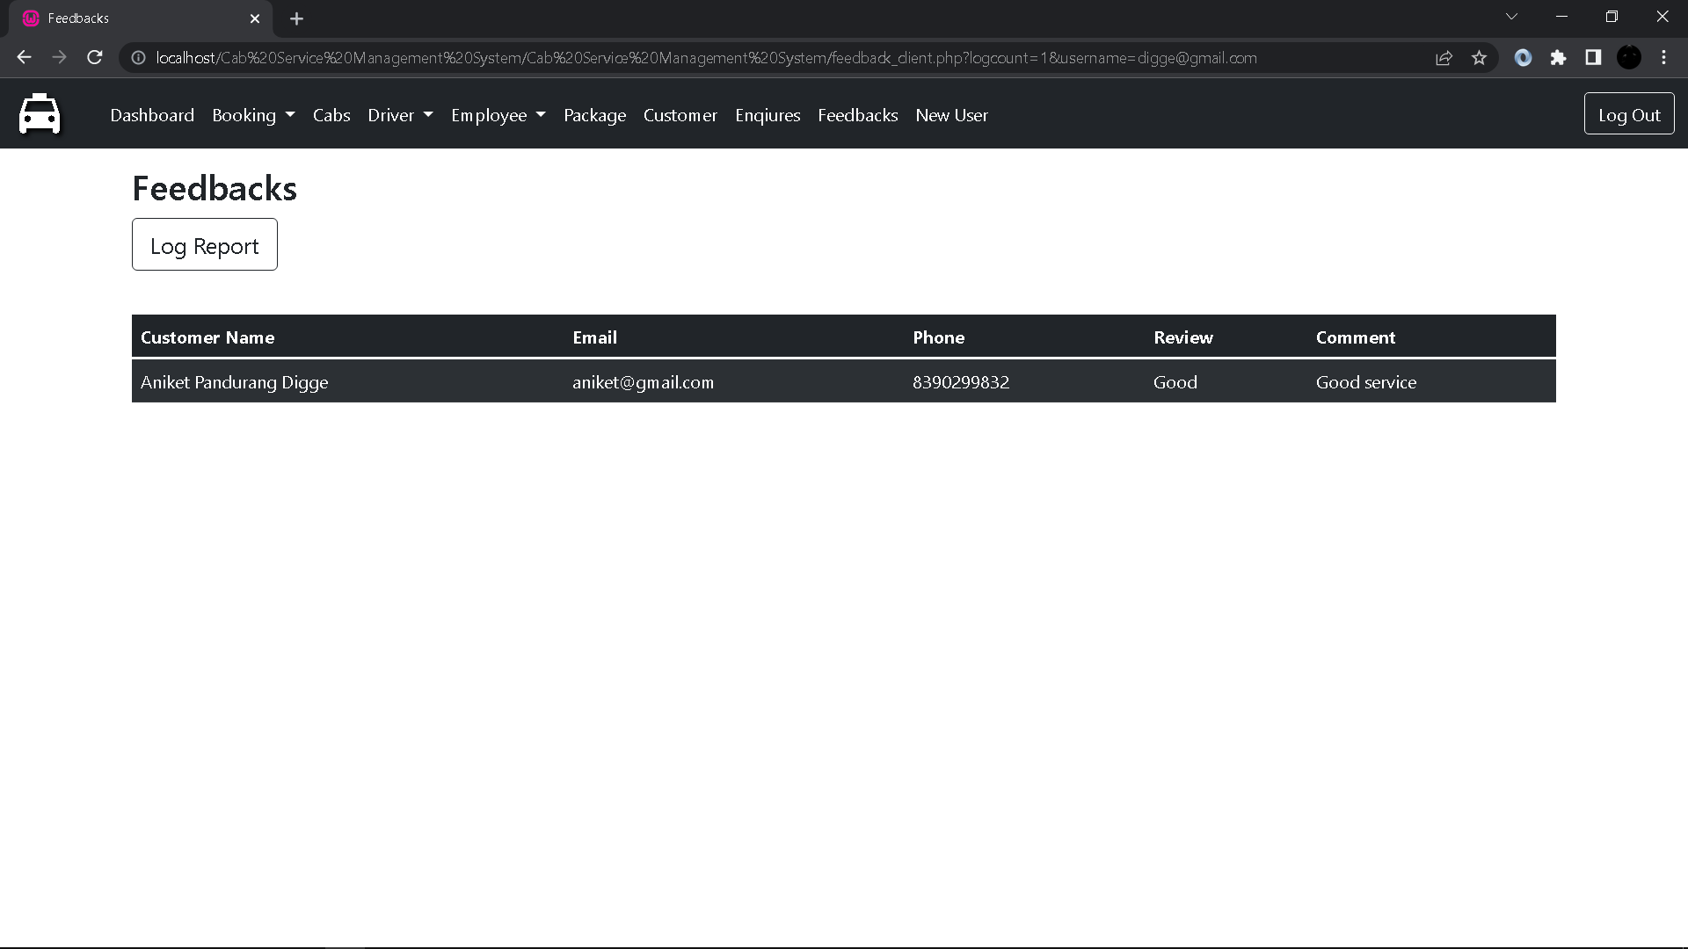
Feedback:

Slide 62

Feedback Log Report:

Slide 63
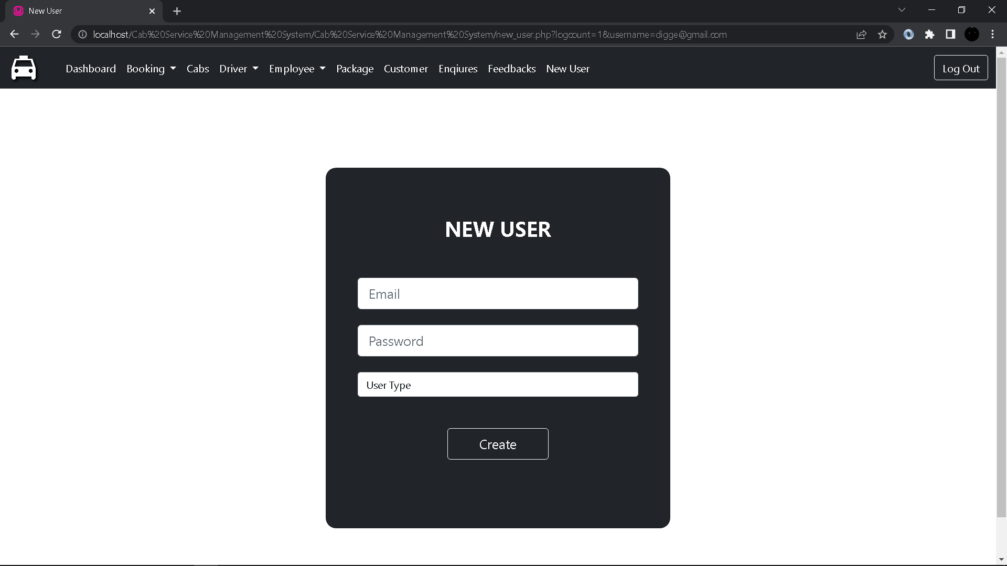
New User:

Slide 64
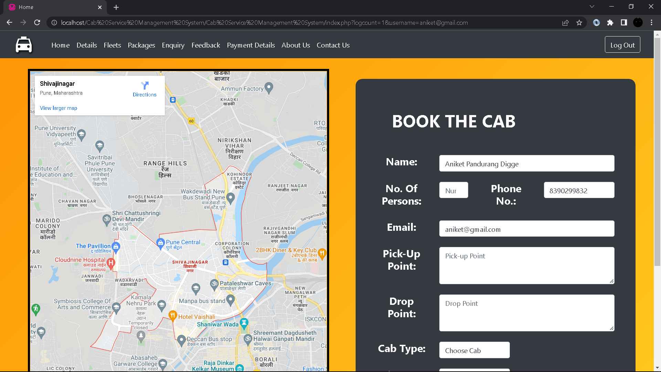
Home:

Slide 65
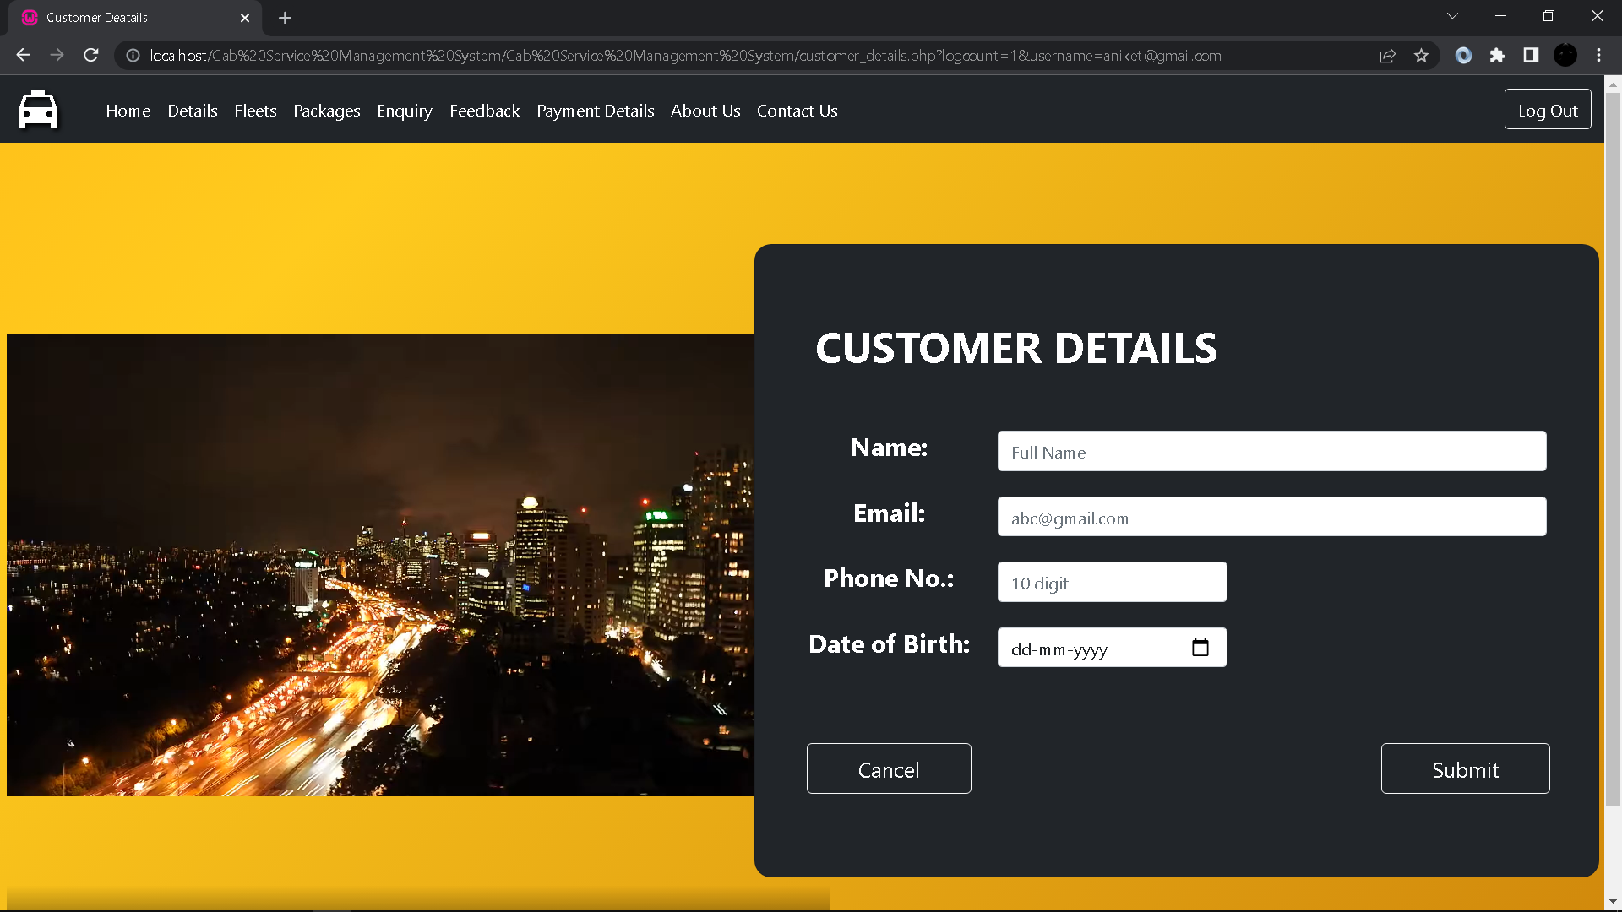
Customer Details:

Slide 66
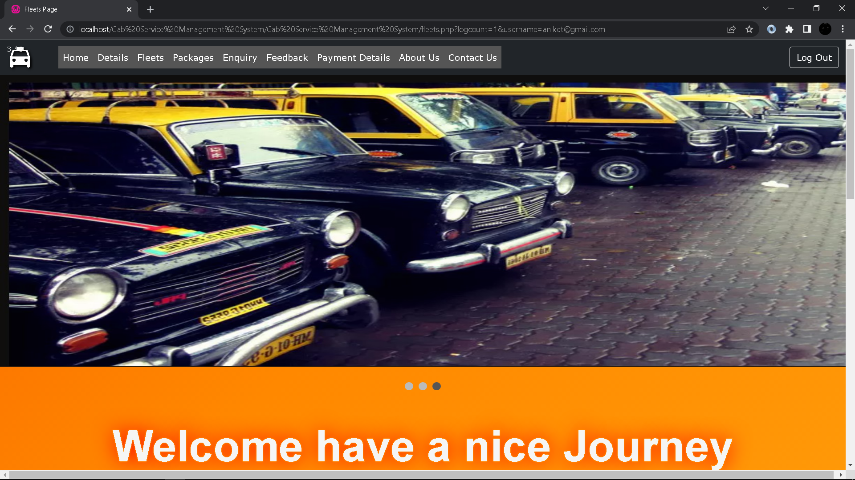
Feelts:

Slide 67

Enquiry:

Slide 68

Feedback:

Slide 69

Payment Details:

Slide 70

About Us:

Slide 71

Contact Us:

Slide 72
Thank you
धन्यवाद

